Slide 1
Capstone Project Update
AuE-8360 Scaled Autonomous Vehicles
Chinmay Samak
PhD Candidate, CU-ICAR
csamak@clemson.edu
Tanmay Samak
PhD Candidate, CU-ICAR
tsamak@clemson.edu

Slide 2



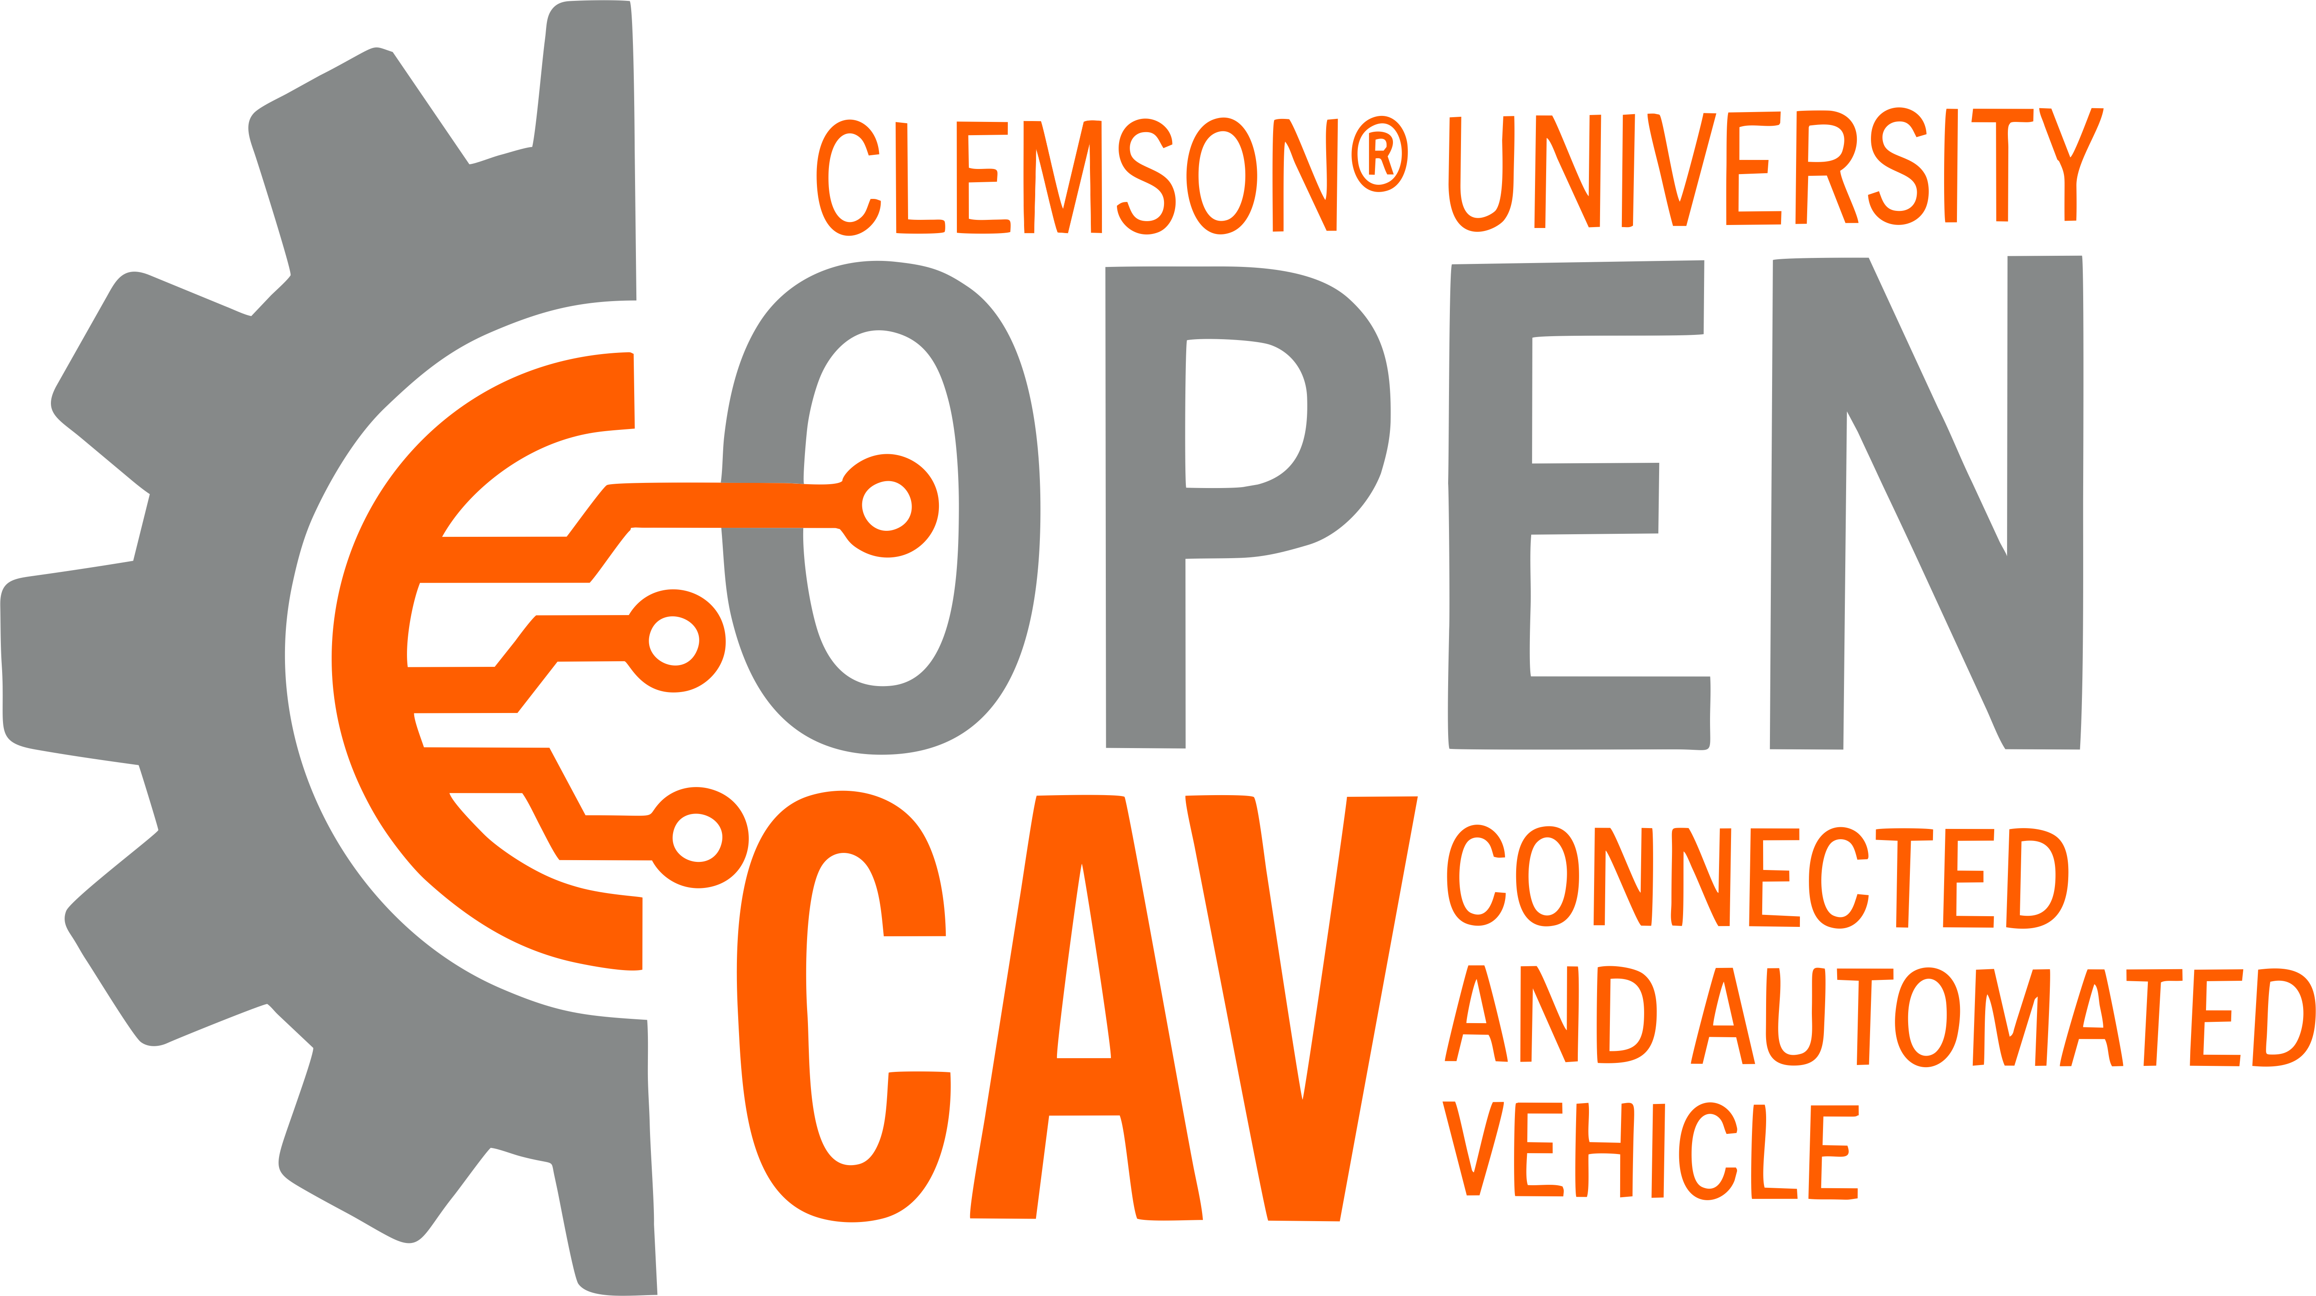
Planned Project Objectives
Theme: digital twins + vehicle scale + Autoware
ODD focus: on-road autonomous navigation
Platforms:
Small-scale: Nigel/F1TENTH
Mid-scale: Hunter SE
Full-scale: OpenCAV
Simulation: AutoDRIVE Simulator
Software-stack: Autoware Core/Universe
True digital twin framework:
Immersive teleoperation demo
Autoware demo:
Autonomous navigation (waypoint following)

Slide 3
Planned Project Objectives
AuE-8360 Capstone Project (Fall 2023)
Task | 10/18 | 10/25 | 11/01 | 11/08 | 11/15 | 11/22 | 11/29 | 12/06
Announcements
Project Proposal
Phase 1
Phase 2
Phase 3
Project Presentation
Project Report

Slide 4
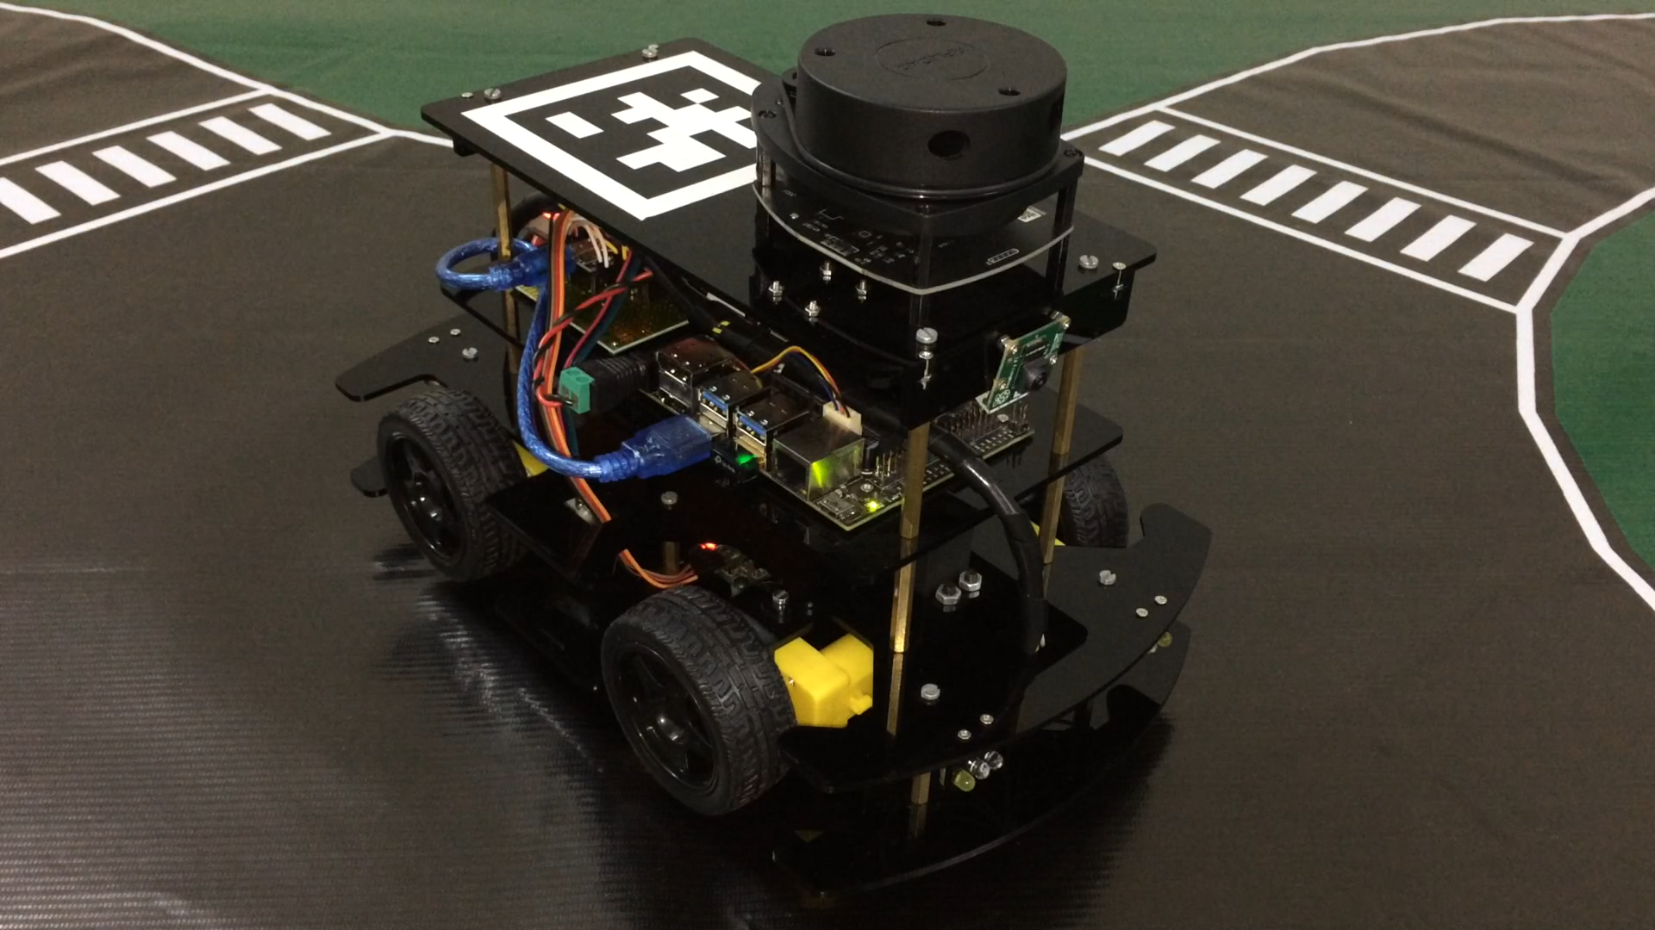
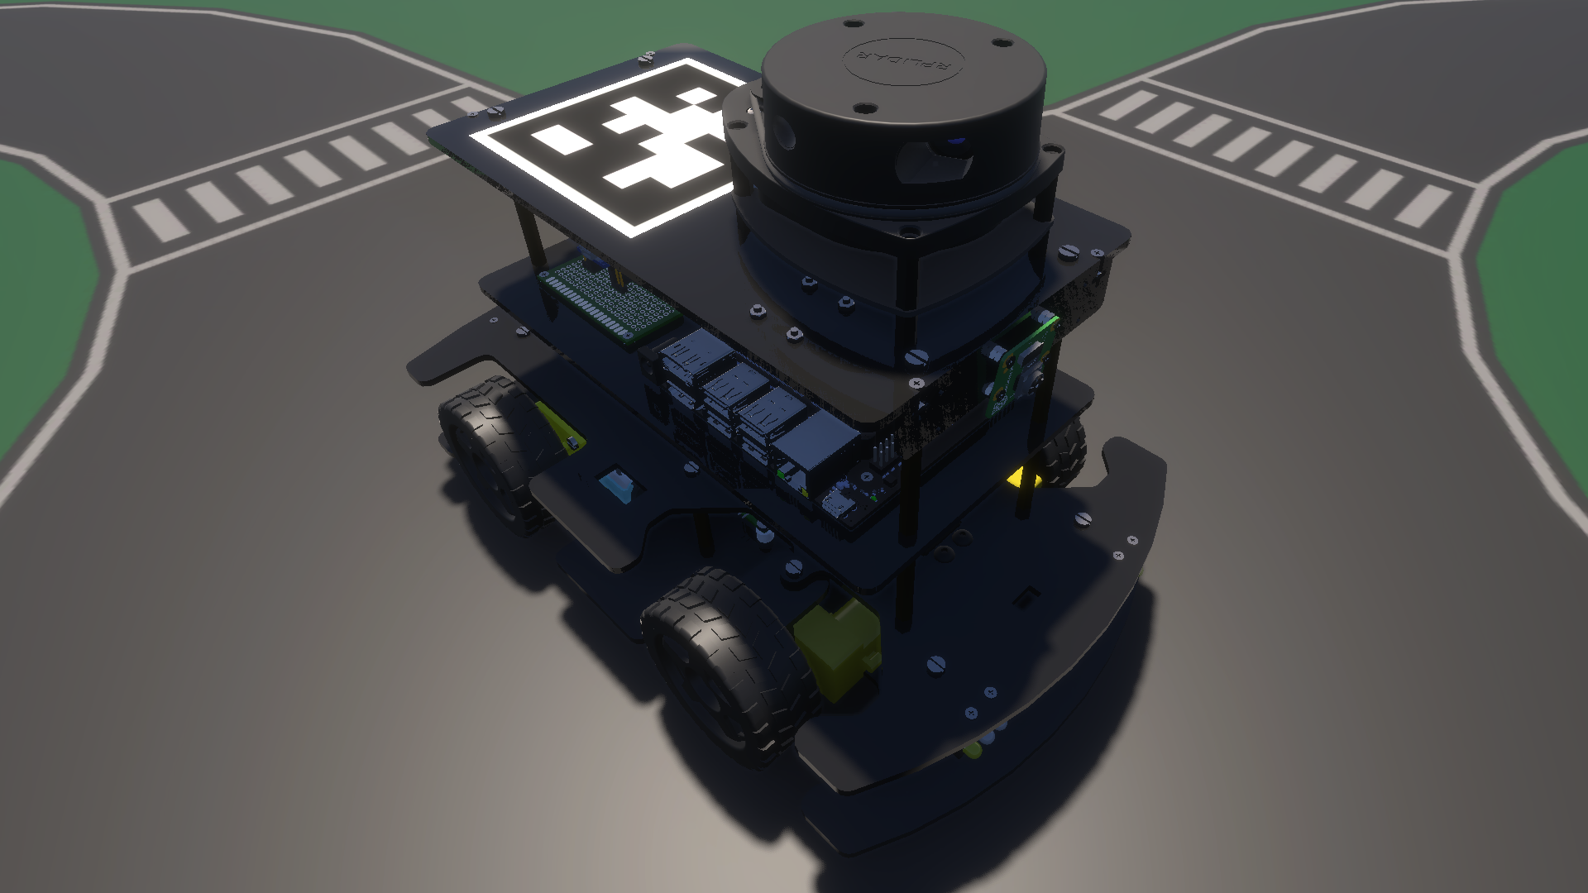
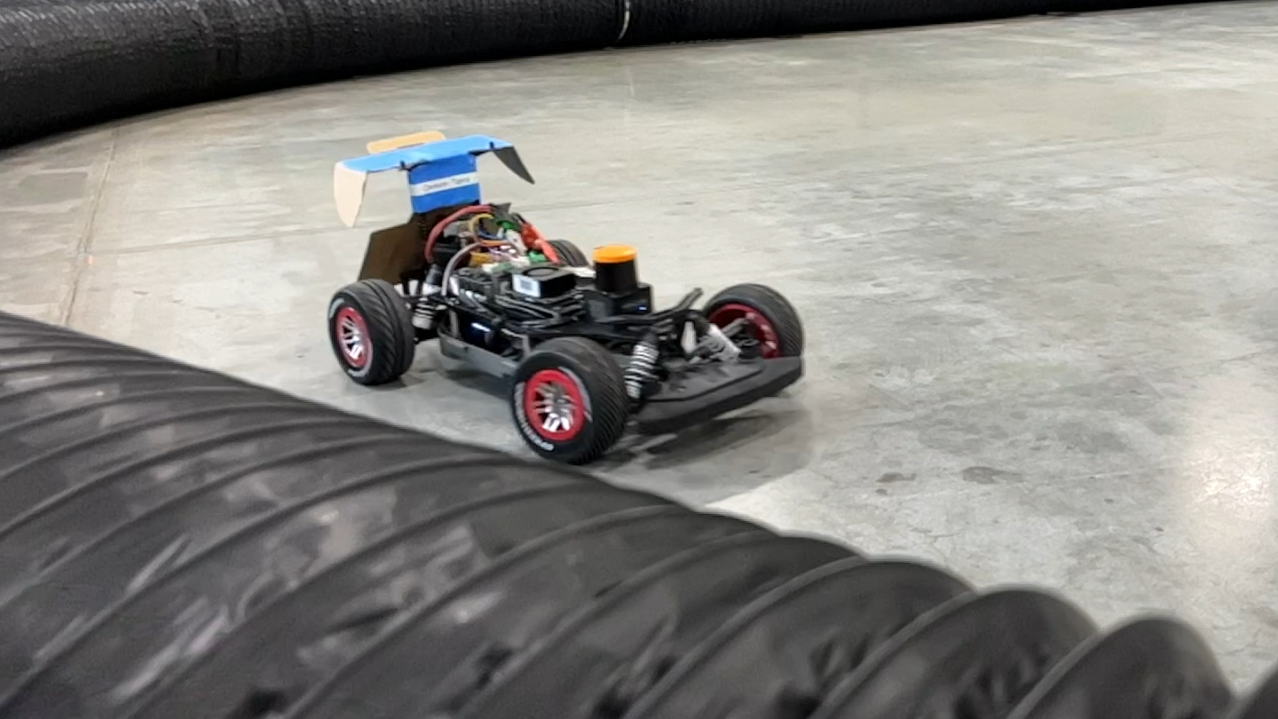
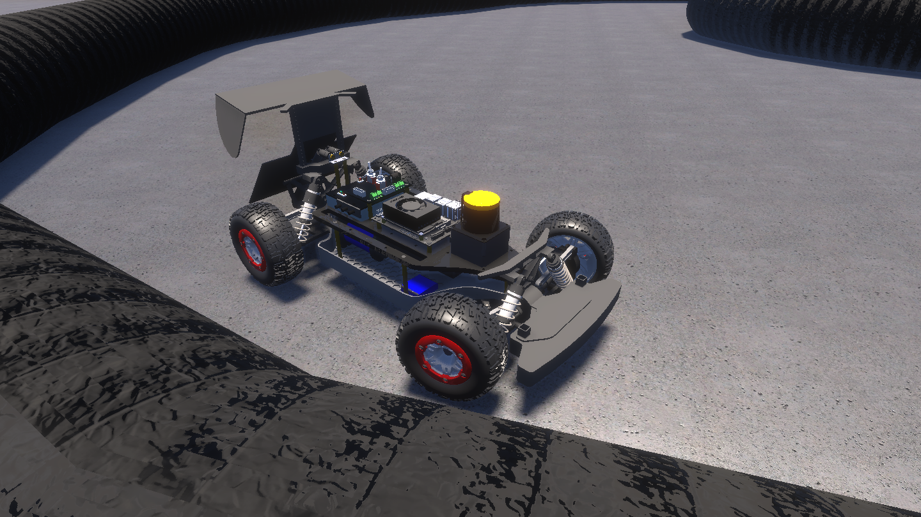
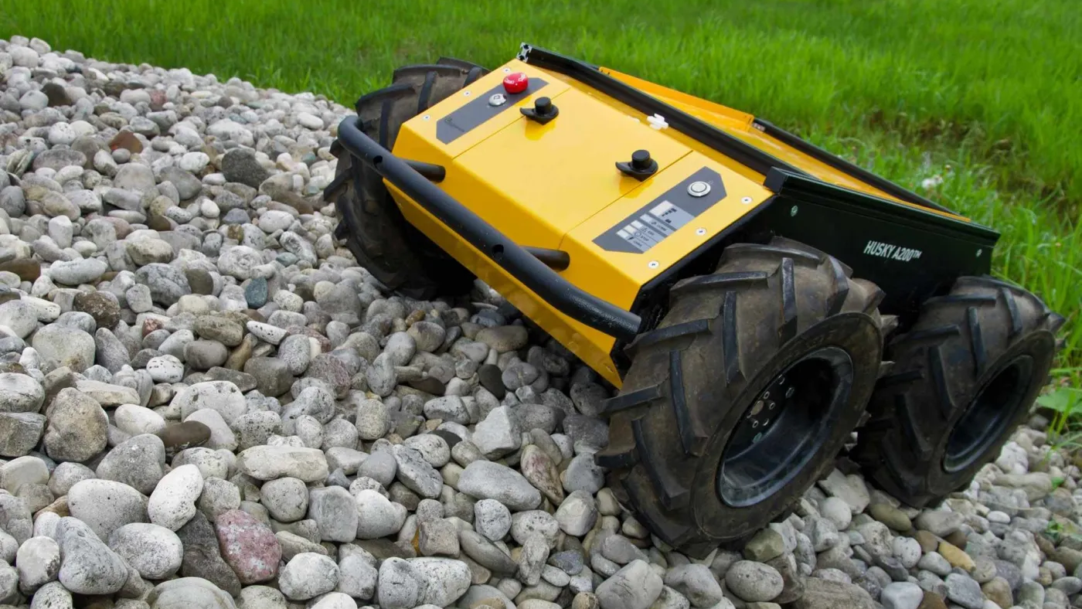
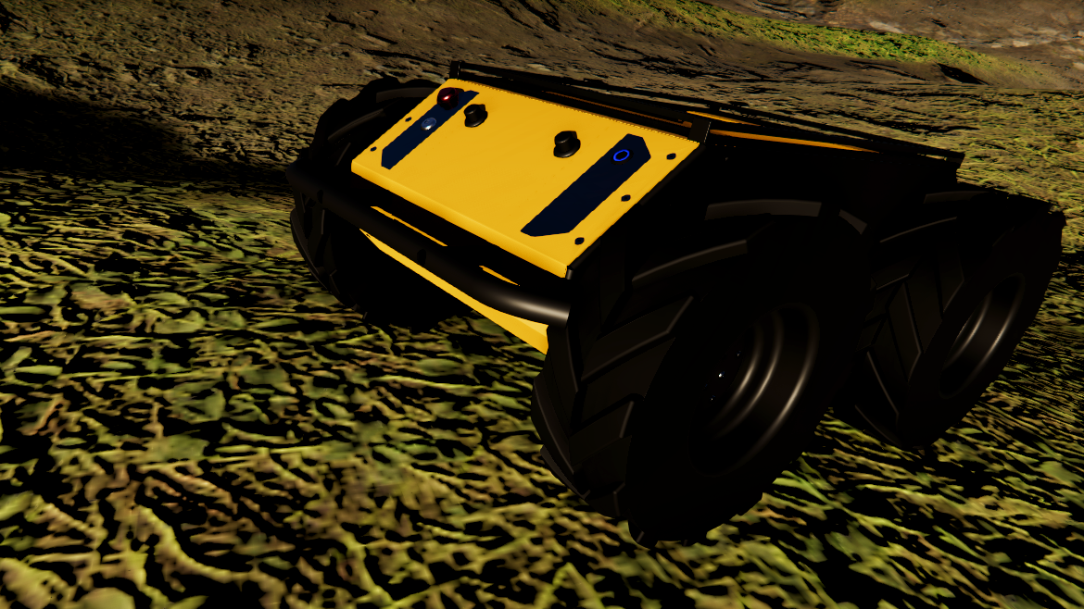
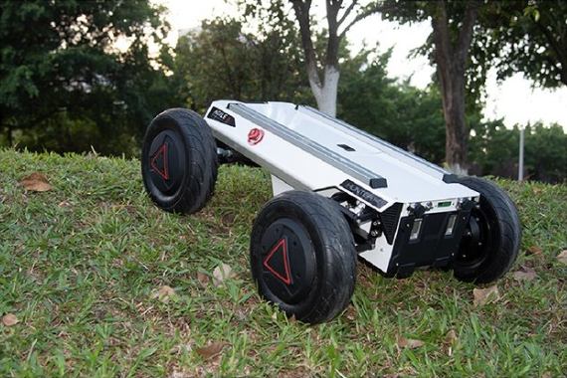
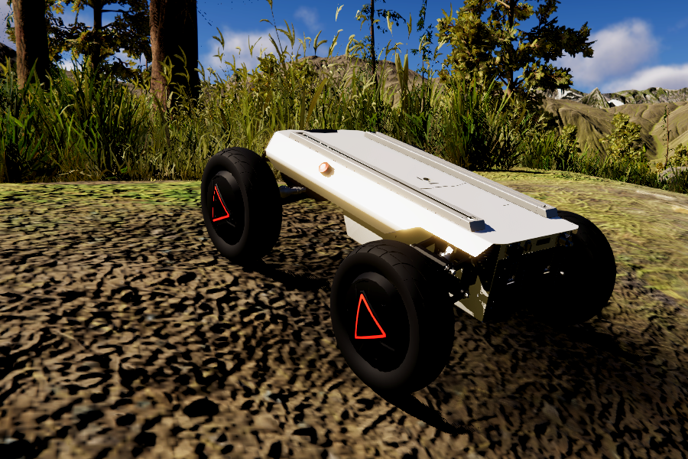
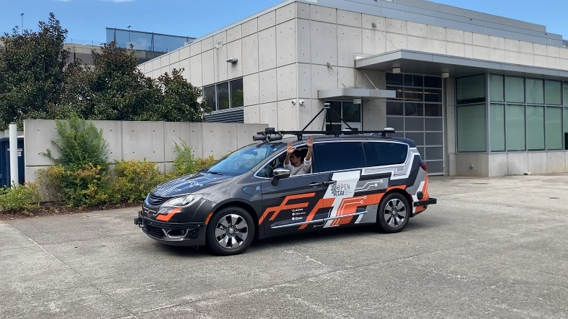
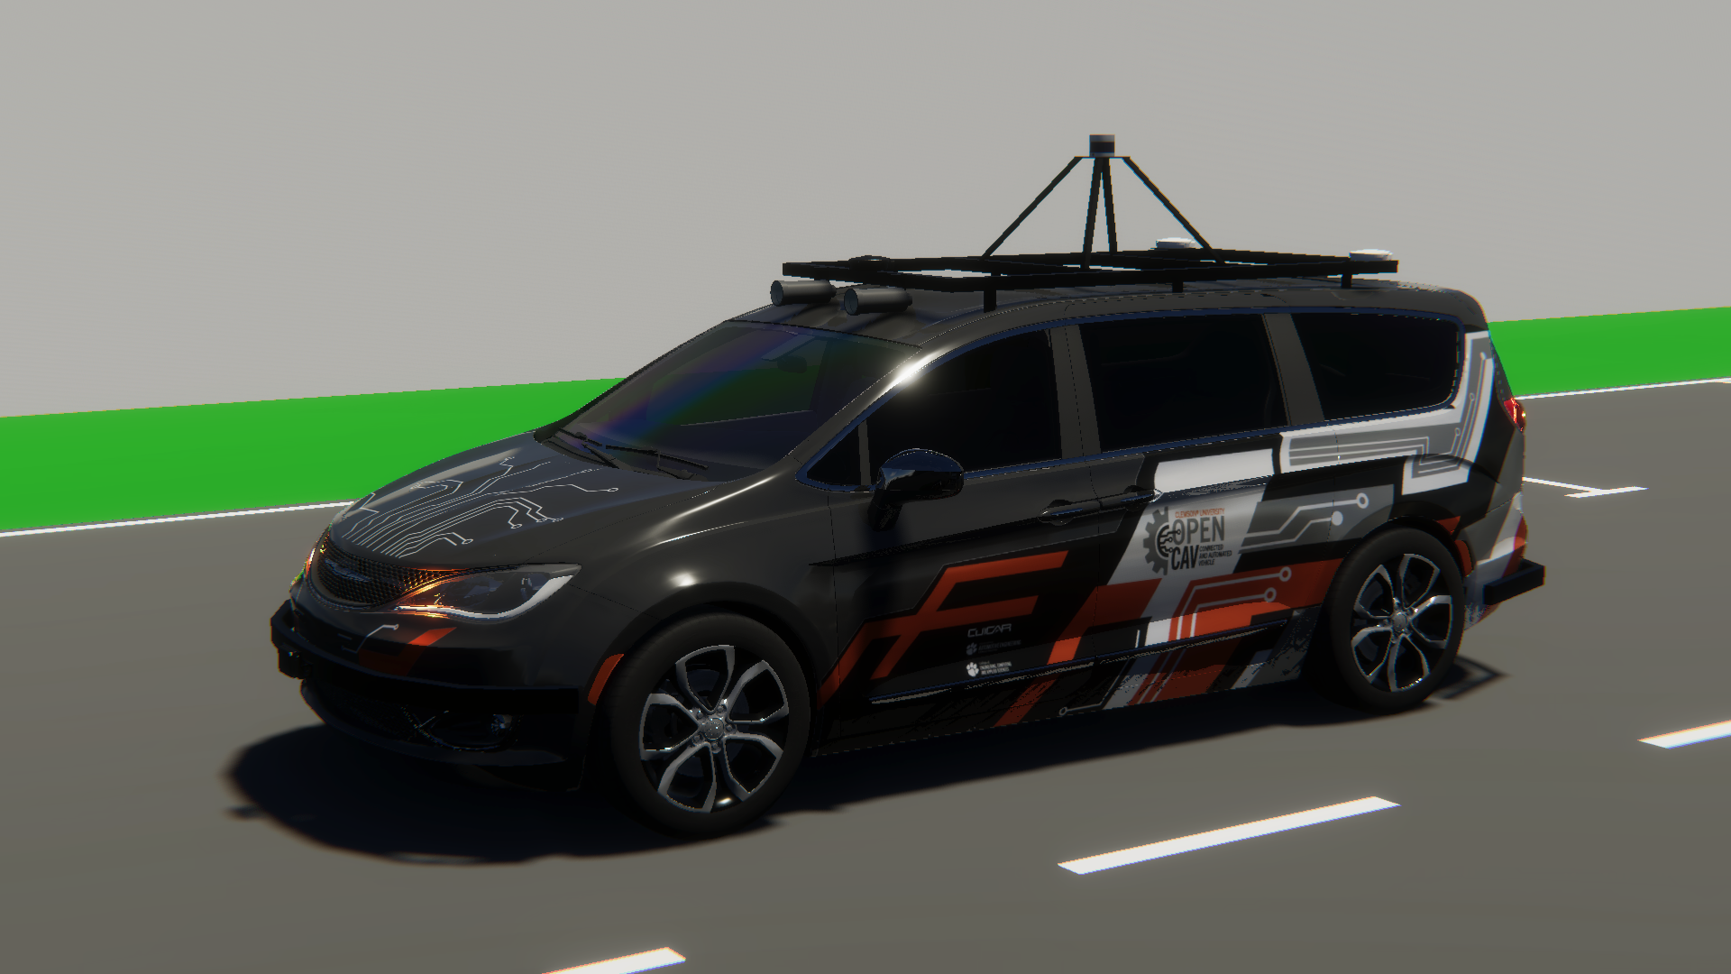
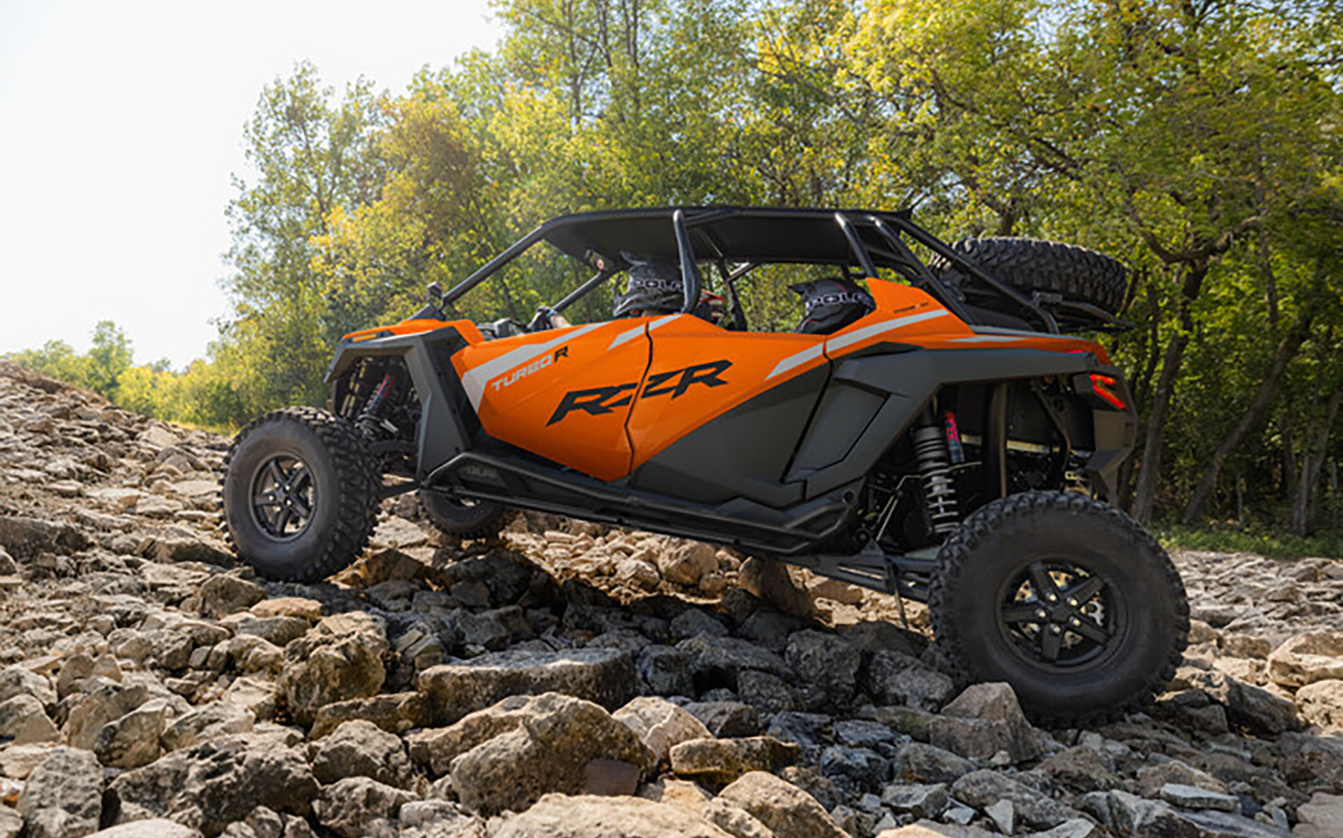
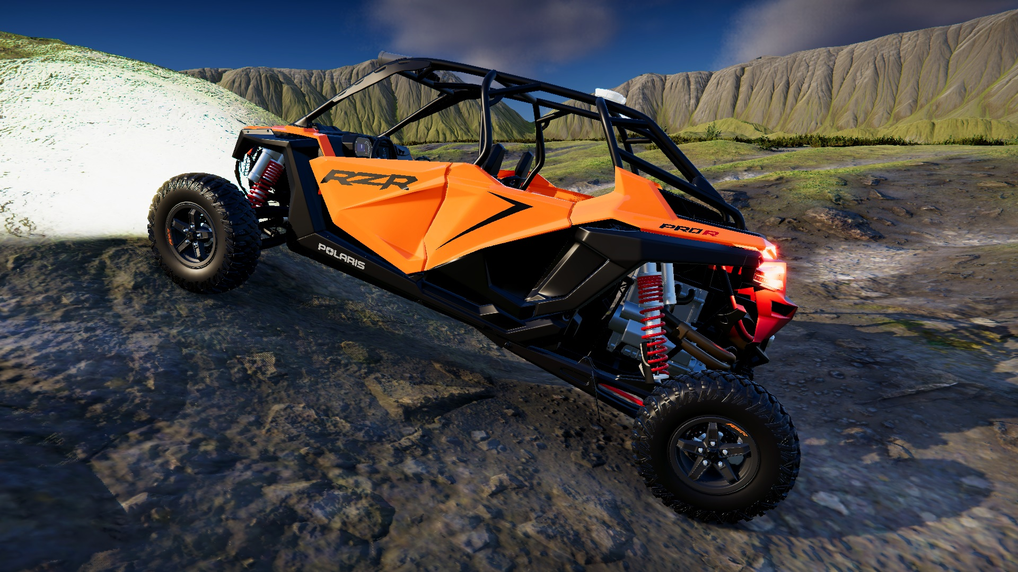
Digital Twin Models in AutoDRIVE Ecosystem
SMALL-SCALE
Nigel (Native Vehicle)
F1TENTH (1/10th Scale Racecar)
MID-SCALE
Husky (On/Off-Road Skid-Steer Robot)
Hunter SE (On/Off-Road Ackermann Steered Vehicle)
FULL-SCALE
OpenCAV (On-Road Commercial Vehicle)
RZR (Recreational Off-Highway Vehicle)
Source: AutoDRIVE Ecosystem

Slide 5
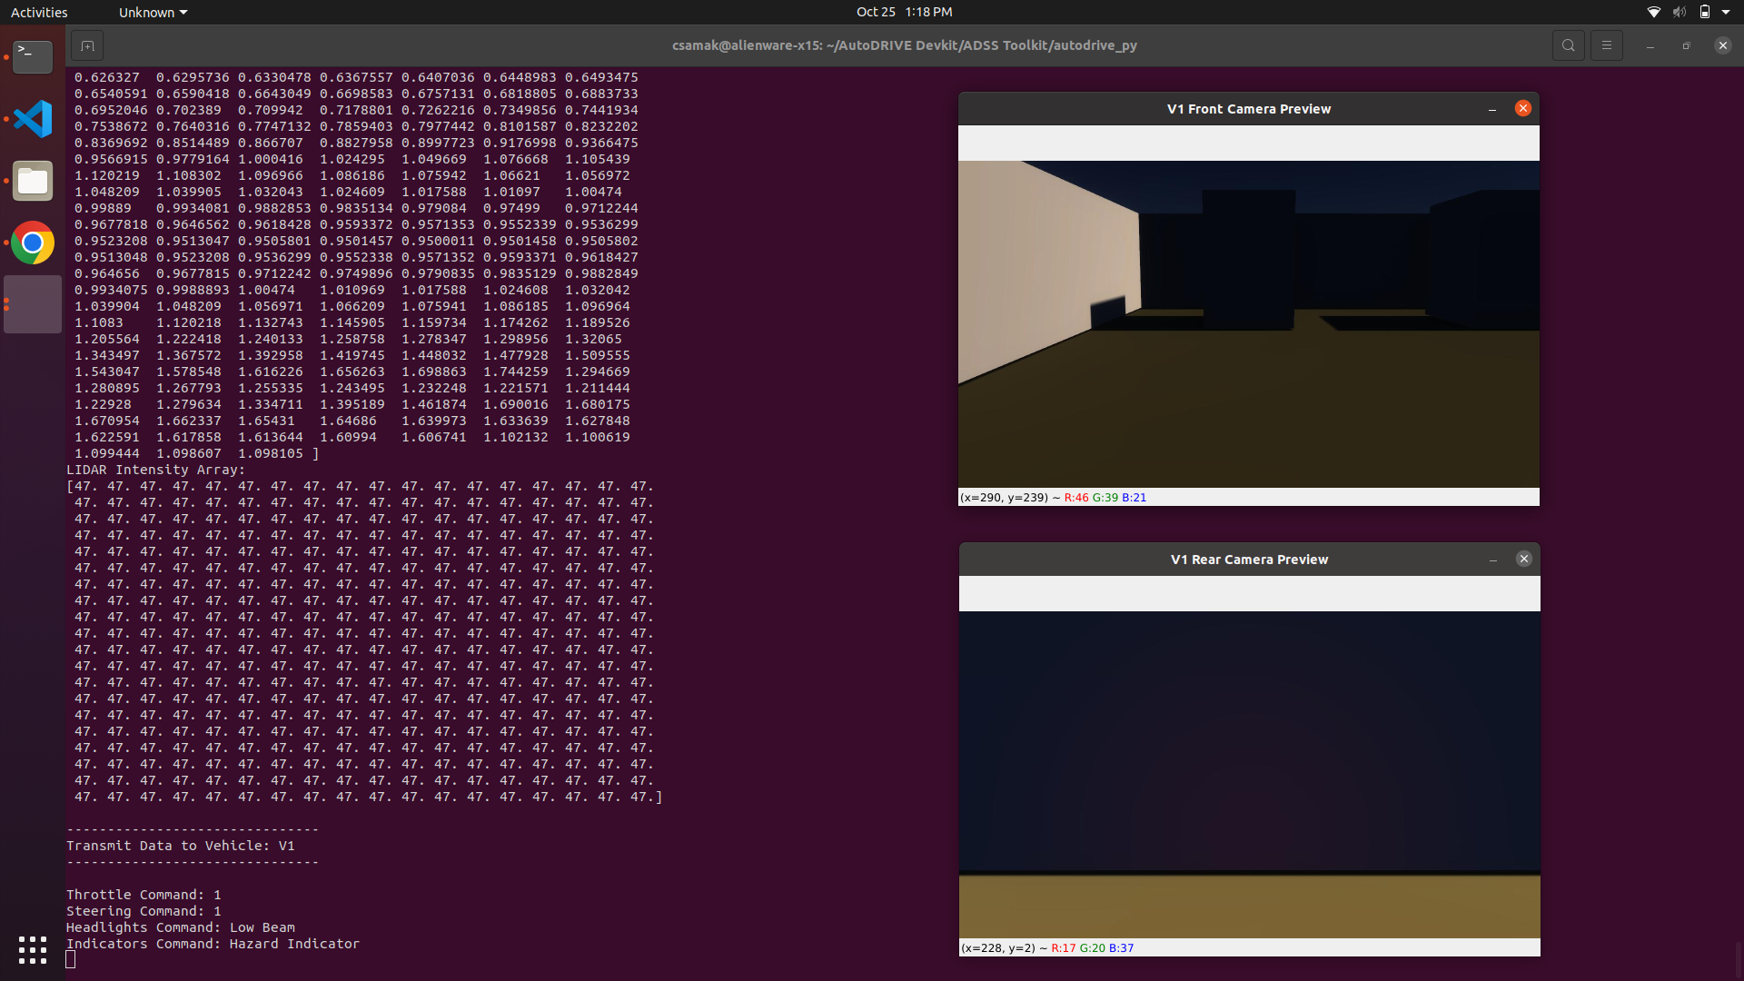
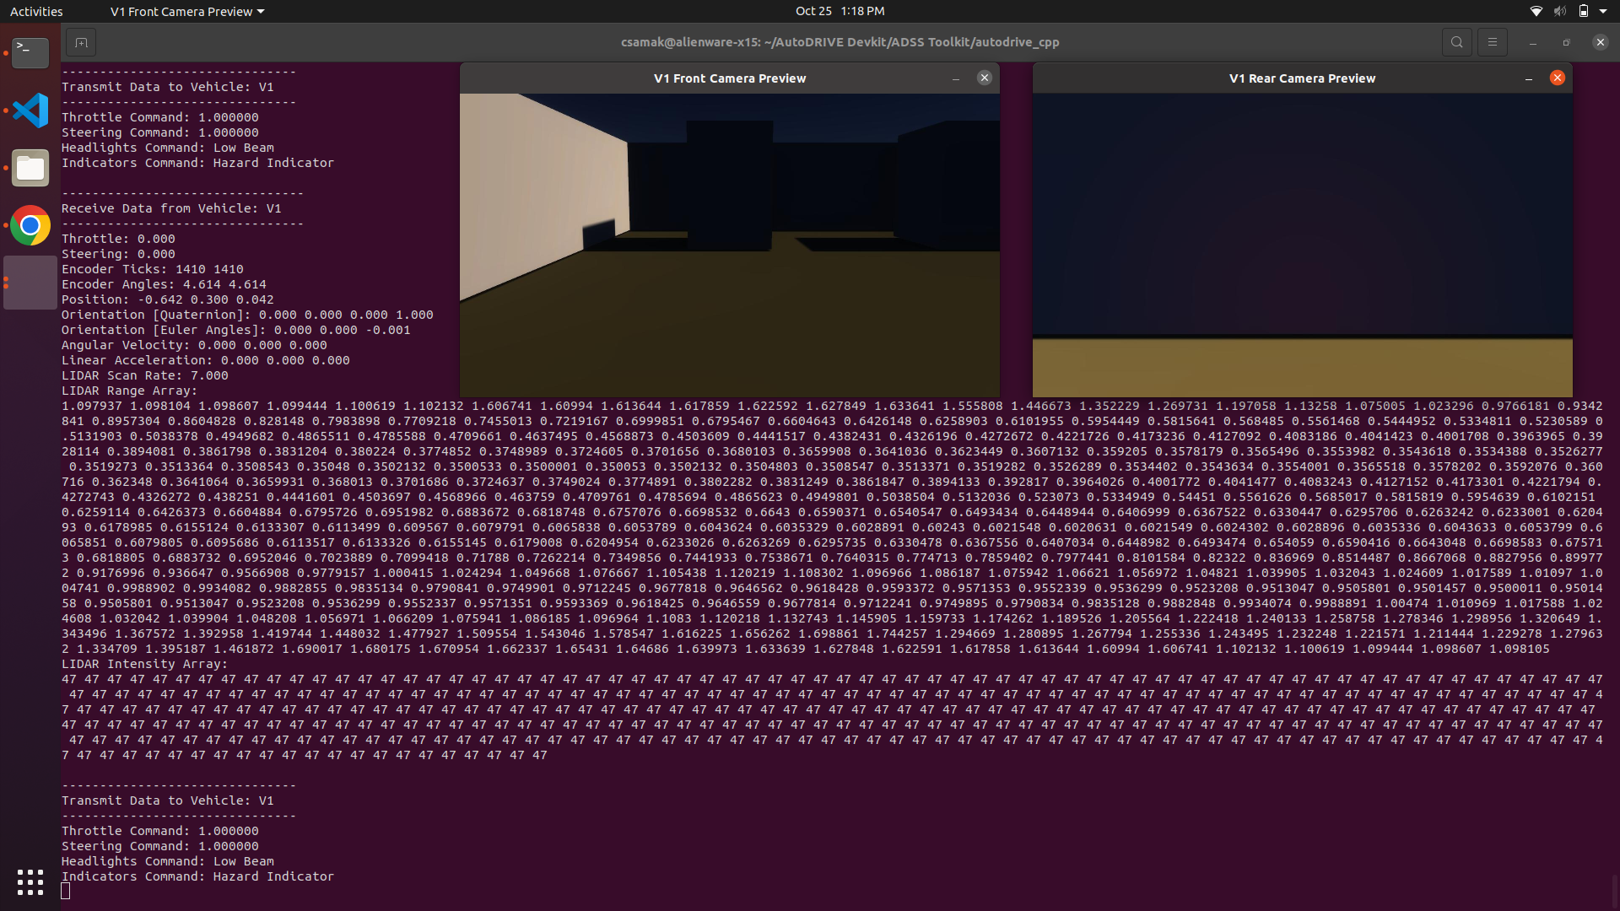
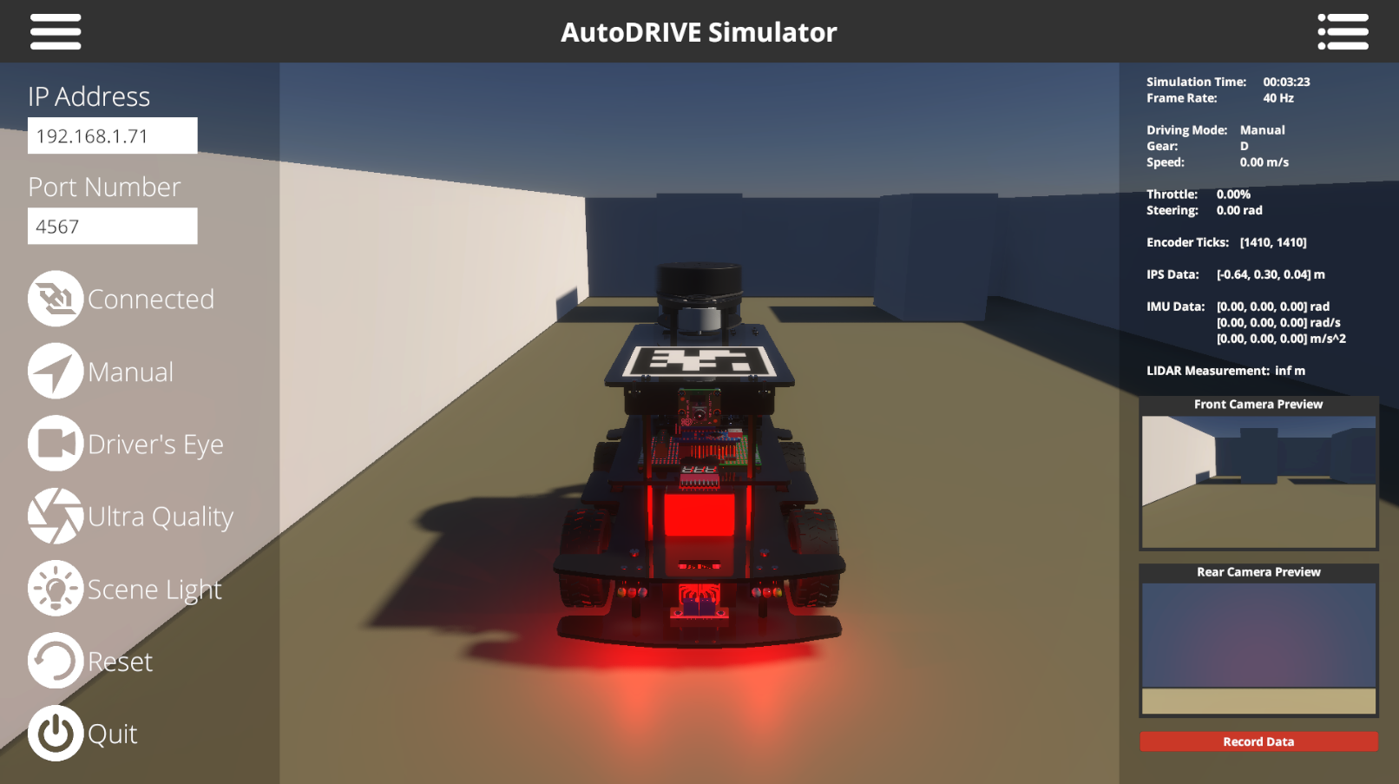


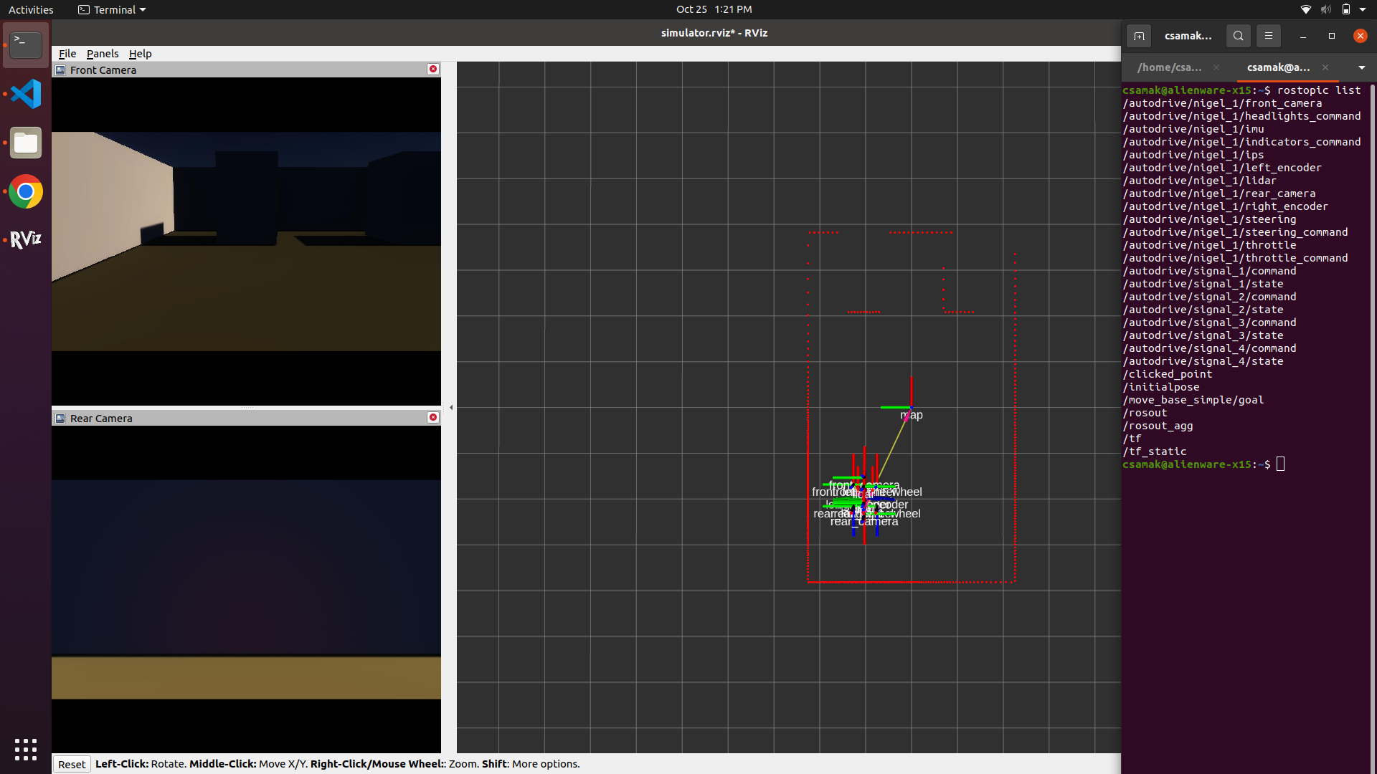
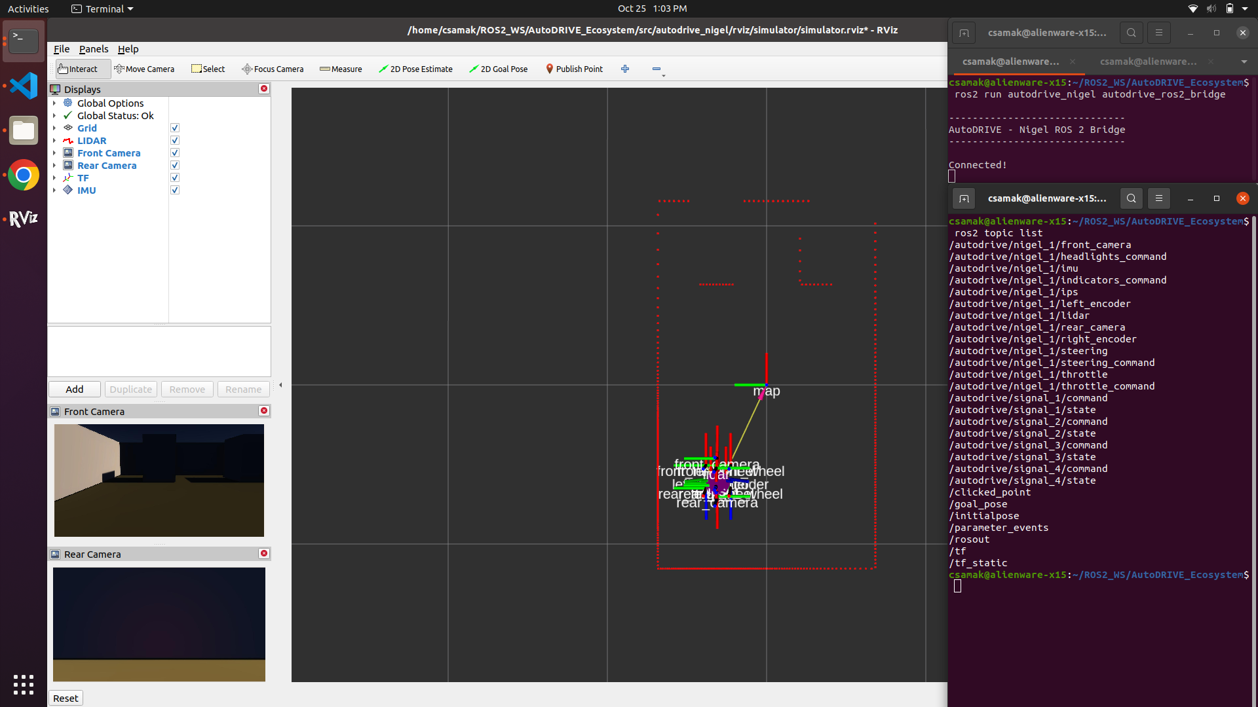


APIs to connect with AutoDRIVE Ecosystem
Python
C++
AutoDRIVE
Autoware Integration Complete!
ROS
ROS 2

Slide 6
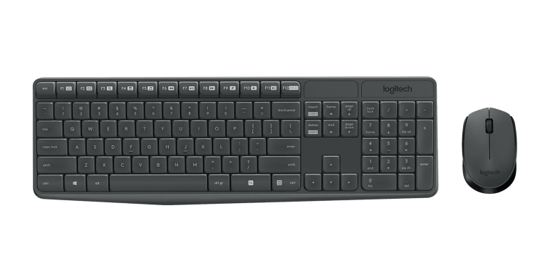
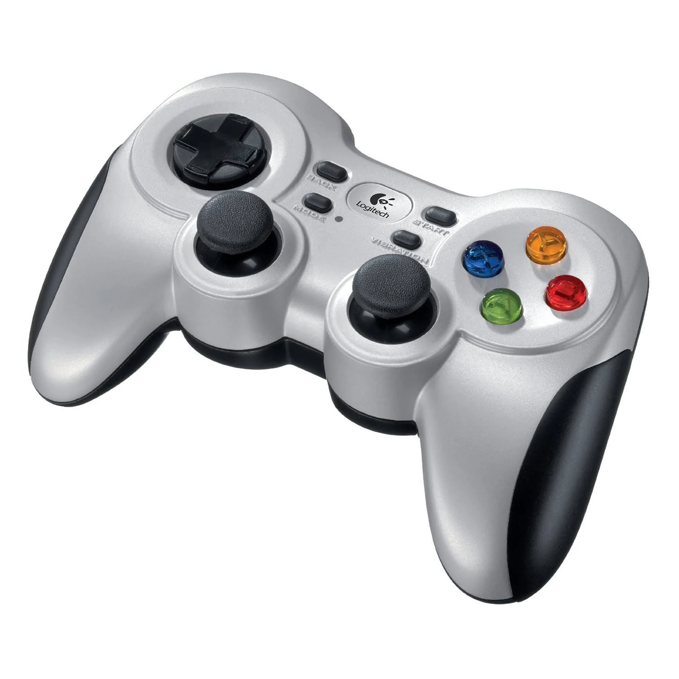
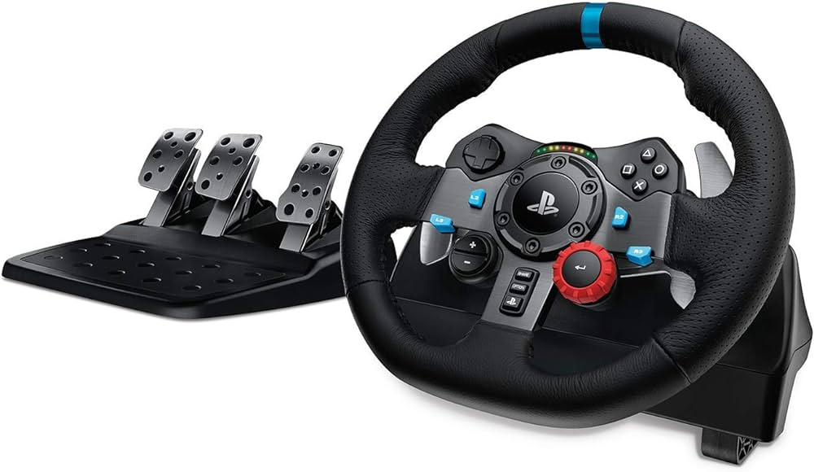

HMIs to connect with AutoDRIVE Ecosystem
AutoDRIVE
Keyboard+Mouse
Gamepad
Driving Rig
Direct HMI vs. API-Mediated HMI
Digital Twin Teleoperation Framework Setup [Demo in Progress]

Slide 7
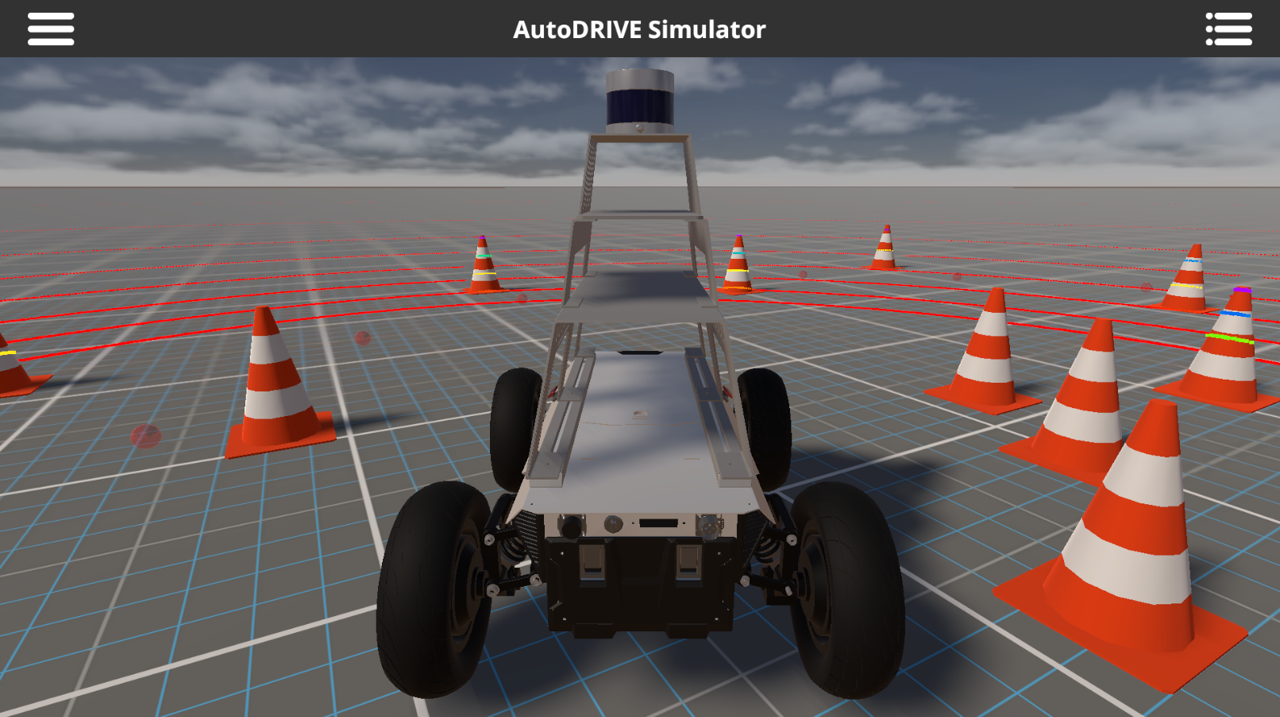
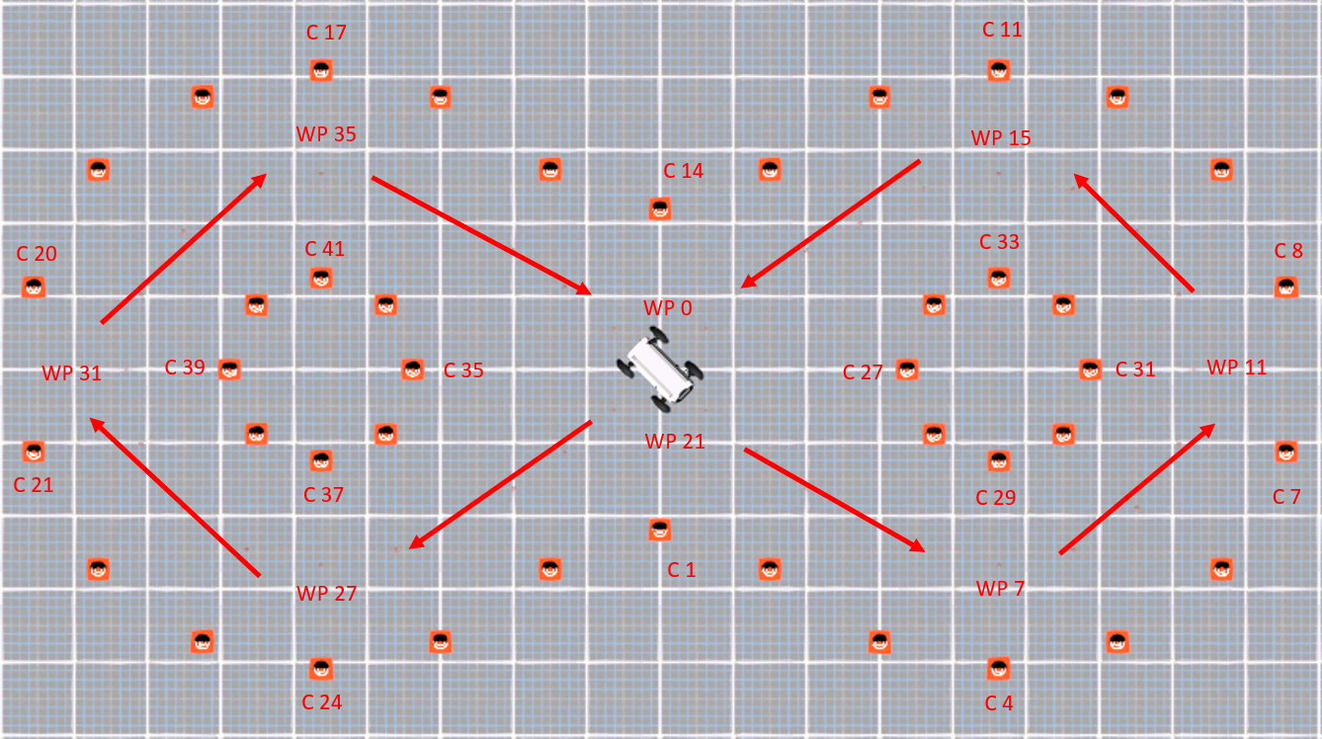
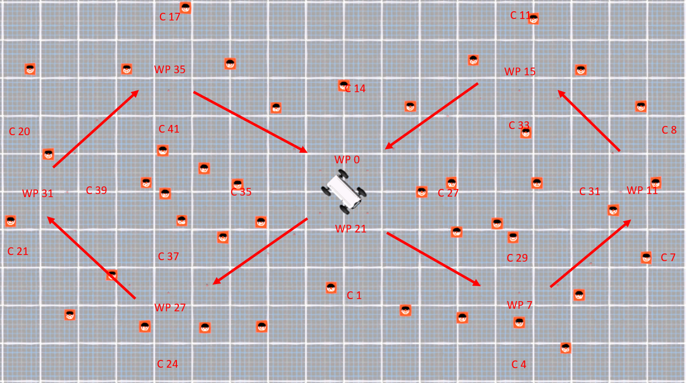
Mid-Scale Vehicle Update Summary
Hunter SE
Frame modeling
Proving ground scenario
Structured/unstructured layout
API development [in progress]
Reduced latency for 3D LIDAR
Husky
Frame modeling
Small off-road scenario
Challenges with 3D LIDAR integration
API development [in progress]
Reduced latency for 3D LIDAR

Slide 8
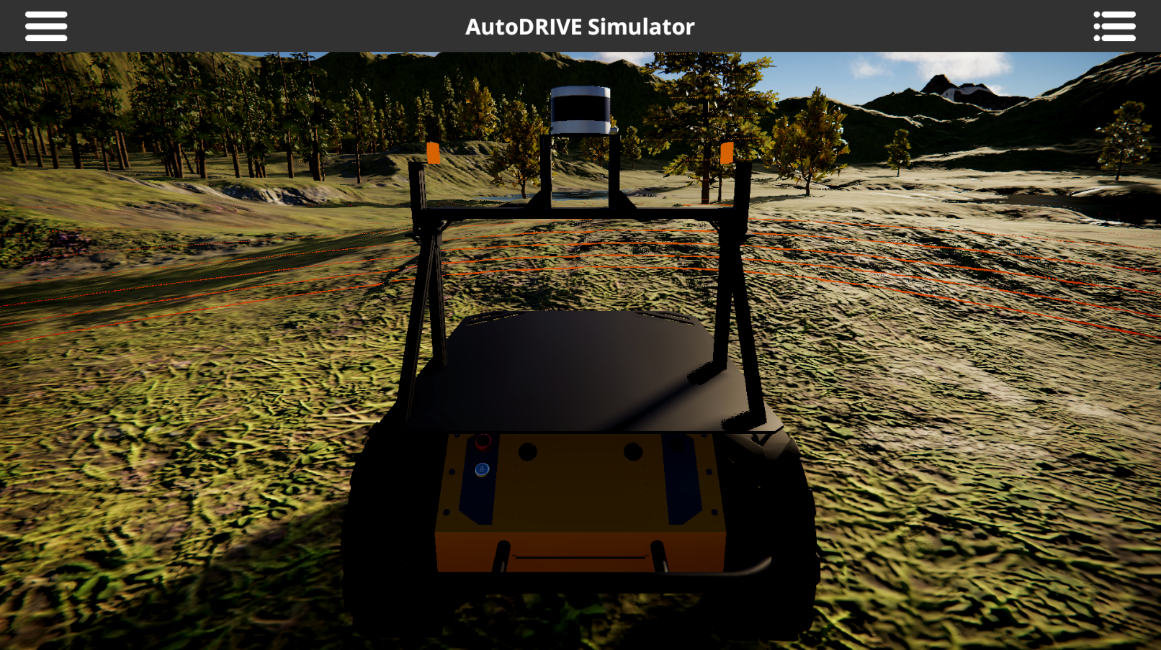
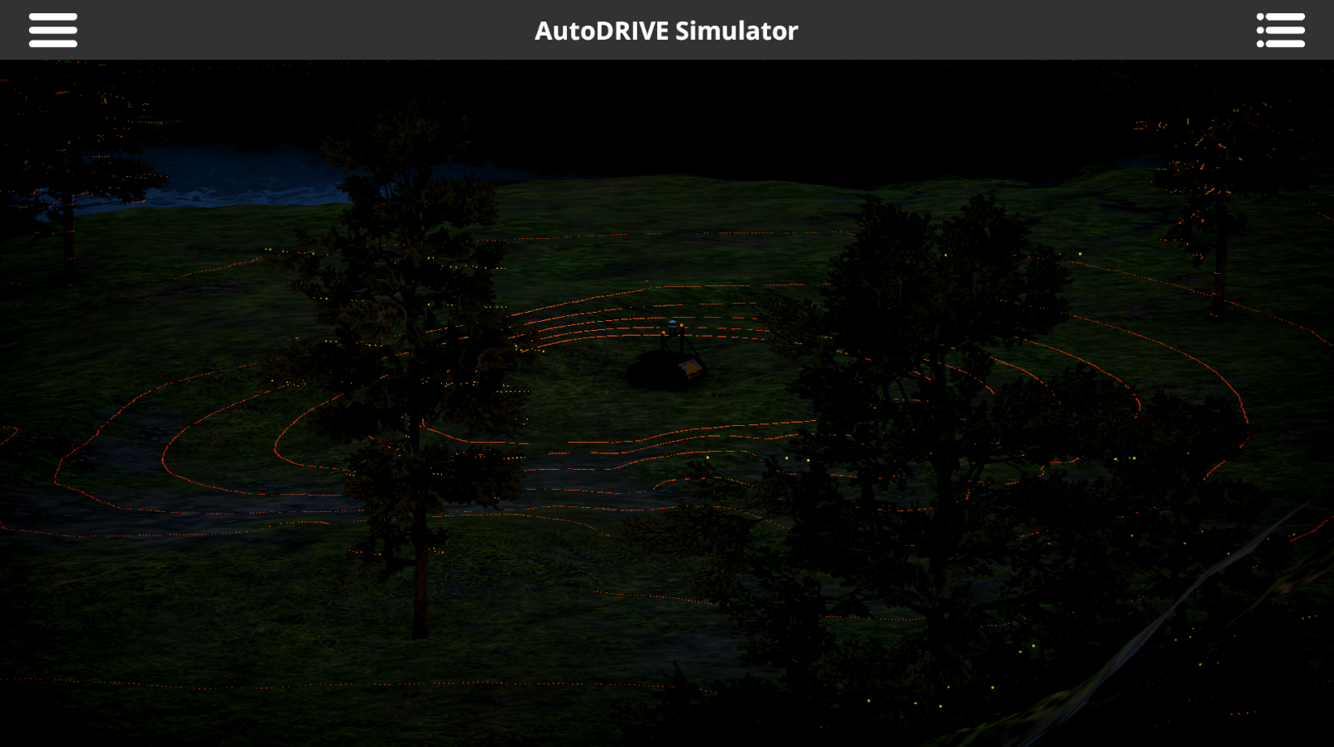
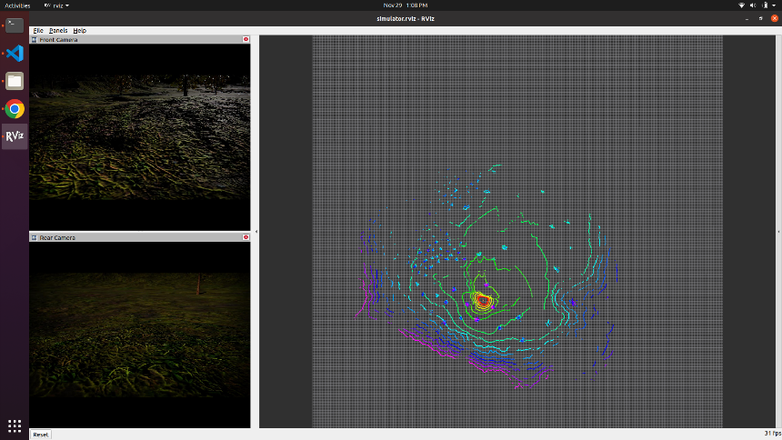
Mid-Scale Vehicle Update Summary
Hunter SE
Frame modeling
Proving ground scenario
Structured/unstructured layout
API development [in progress]
Reduced latency for 3D LIDAR
Husky
Frame modeling
Small off-road scenario
Challenges with 3D LIDAR integration
API development [in progress]
Reduced latency for 3D LIDAR

Slide 9
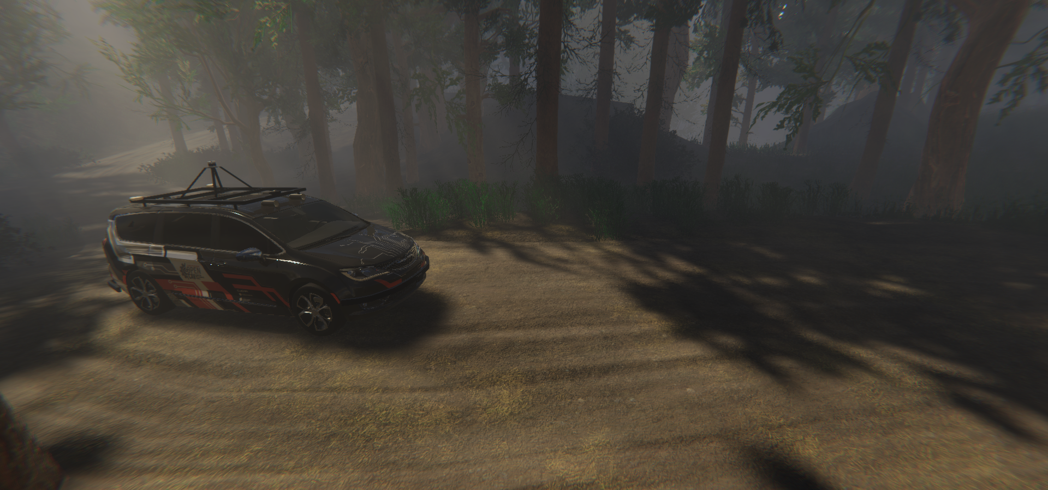
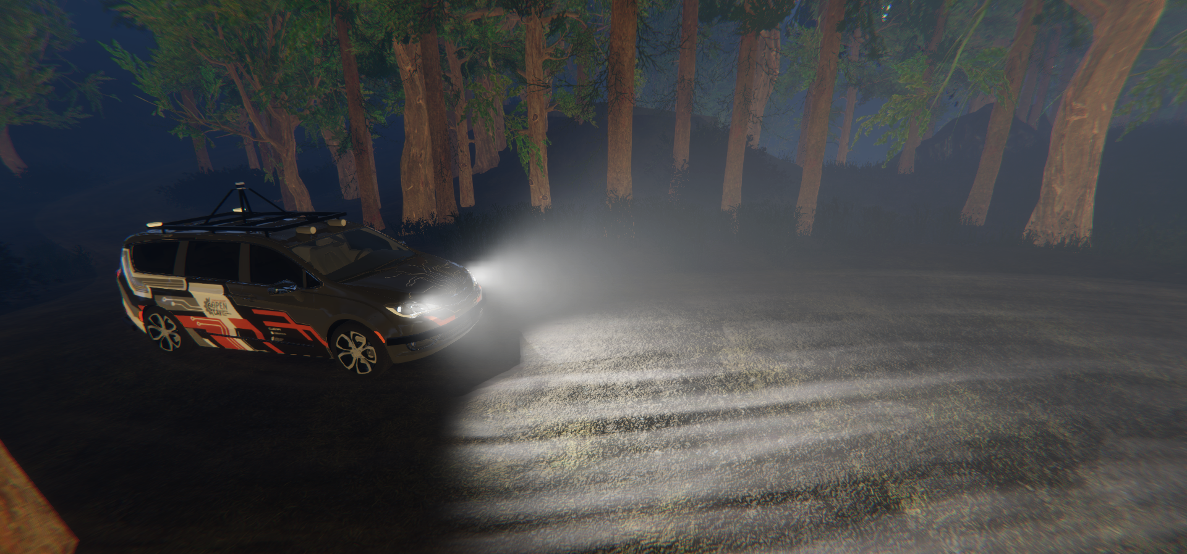
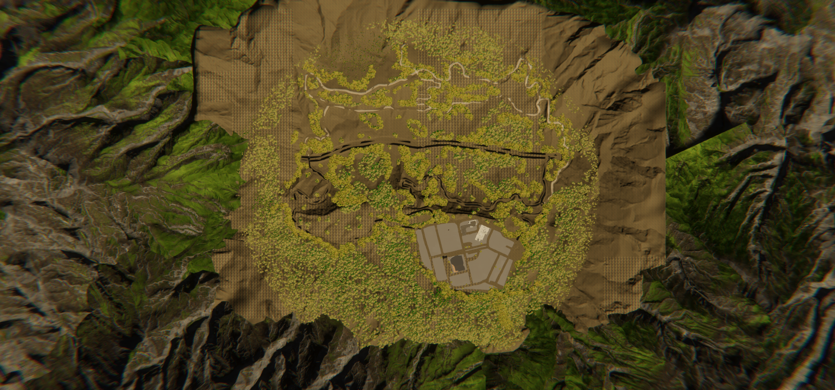
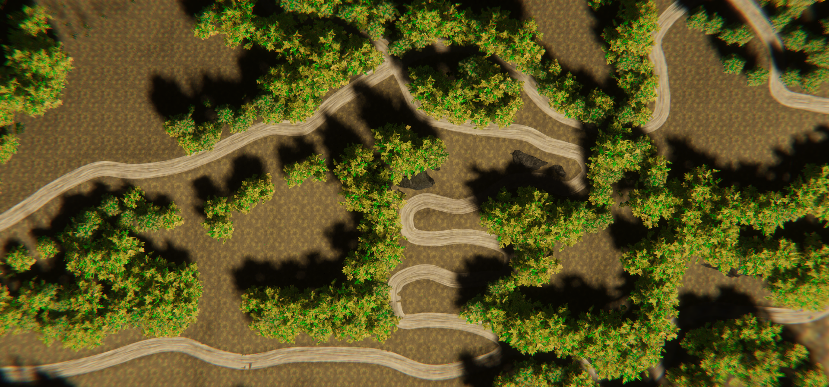
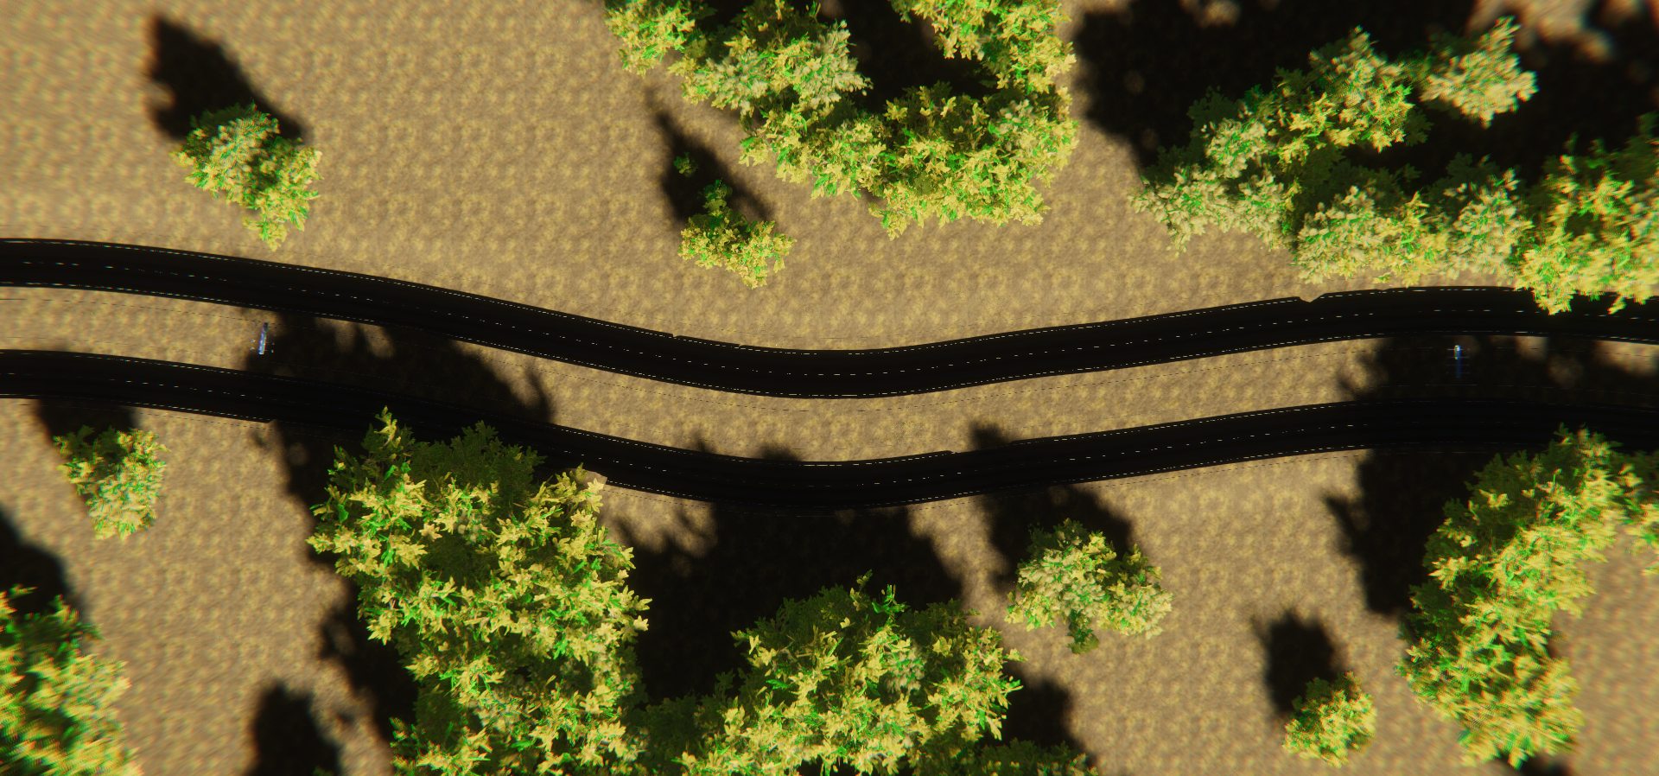
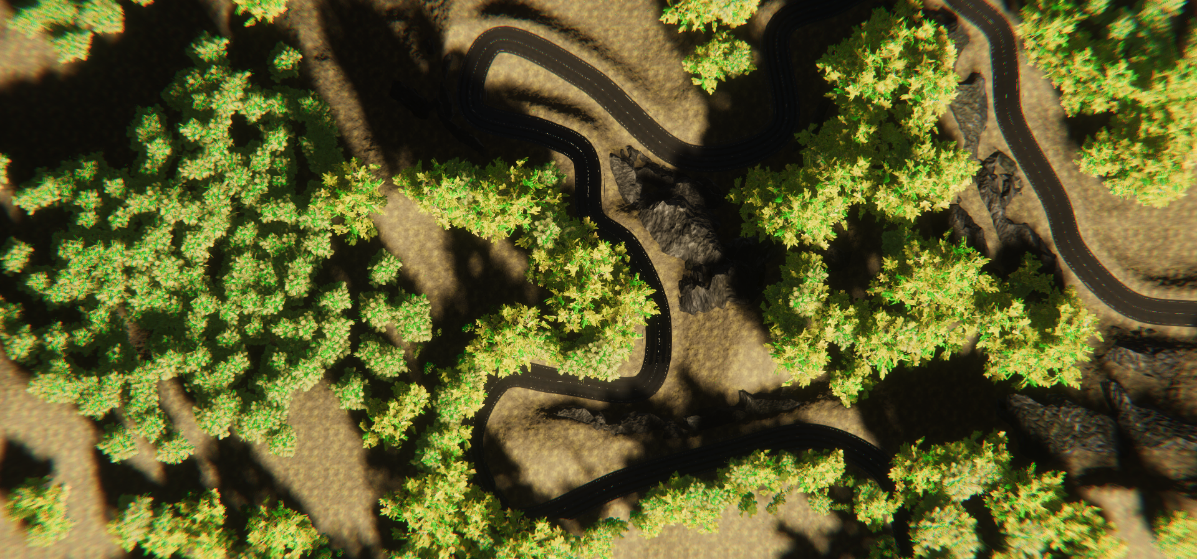
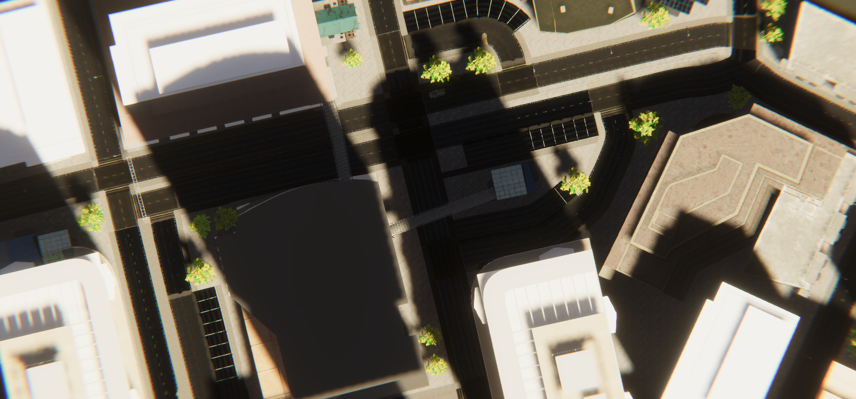
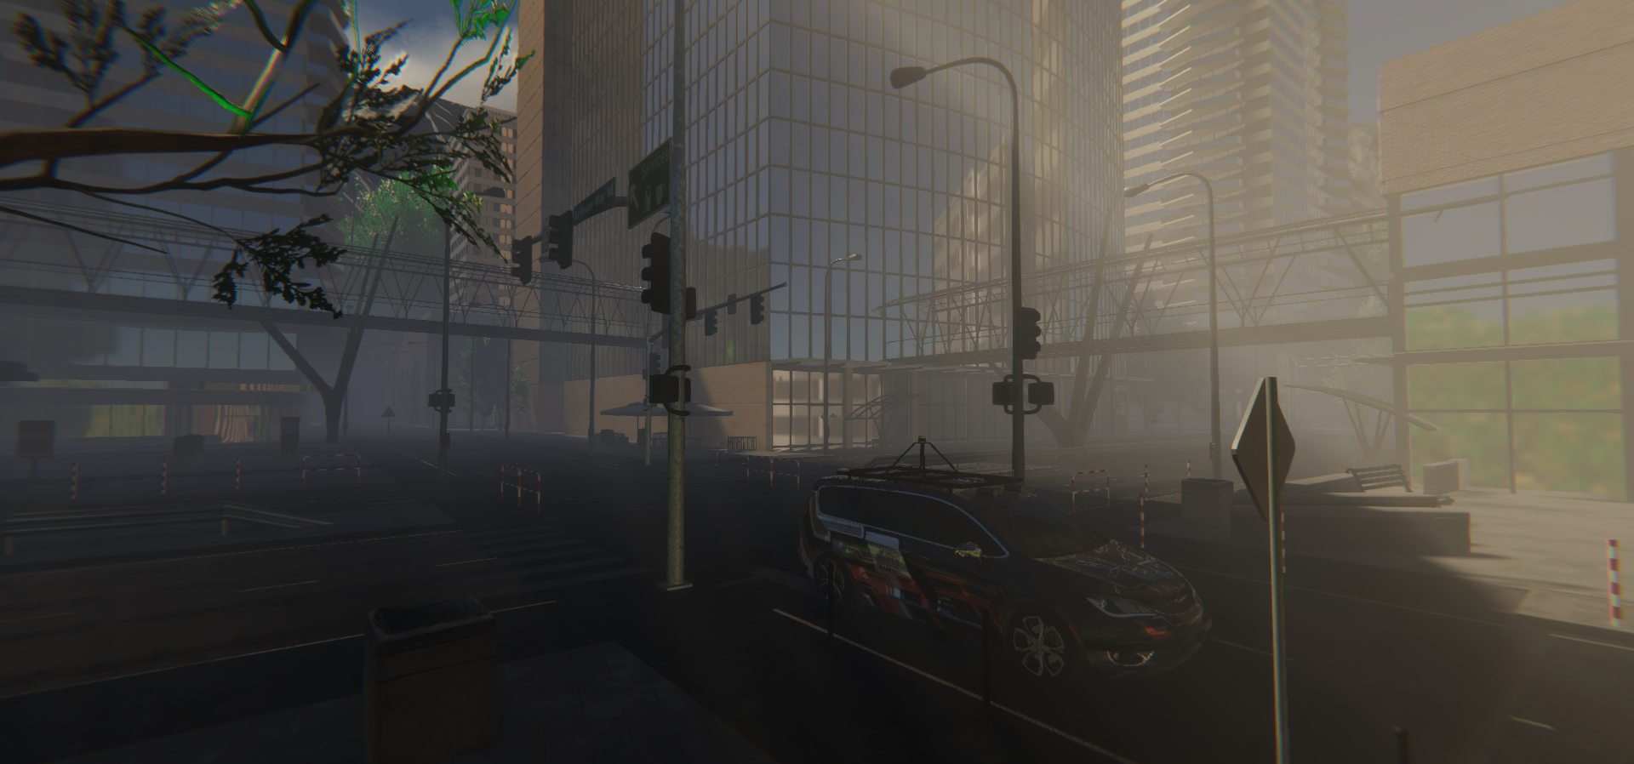
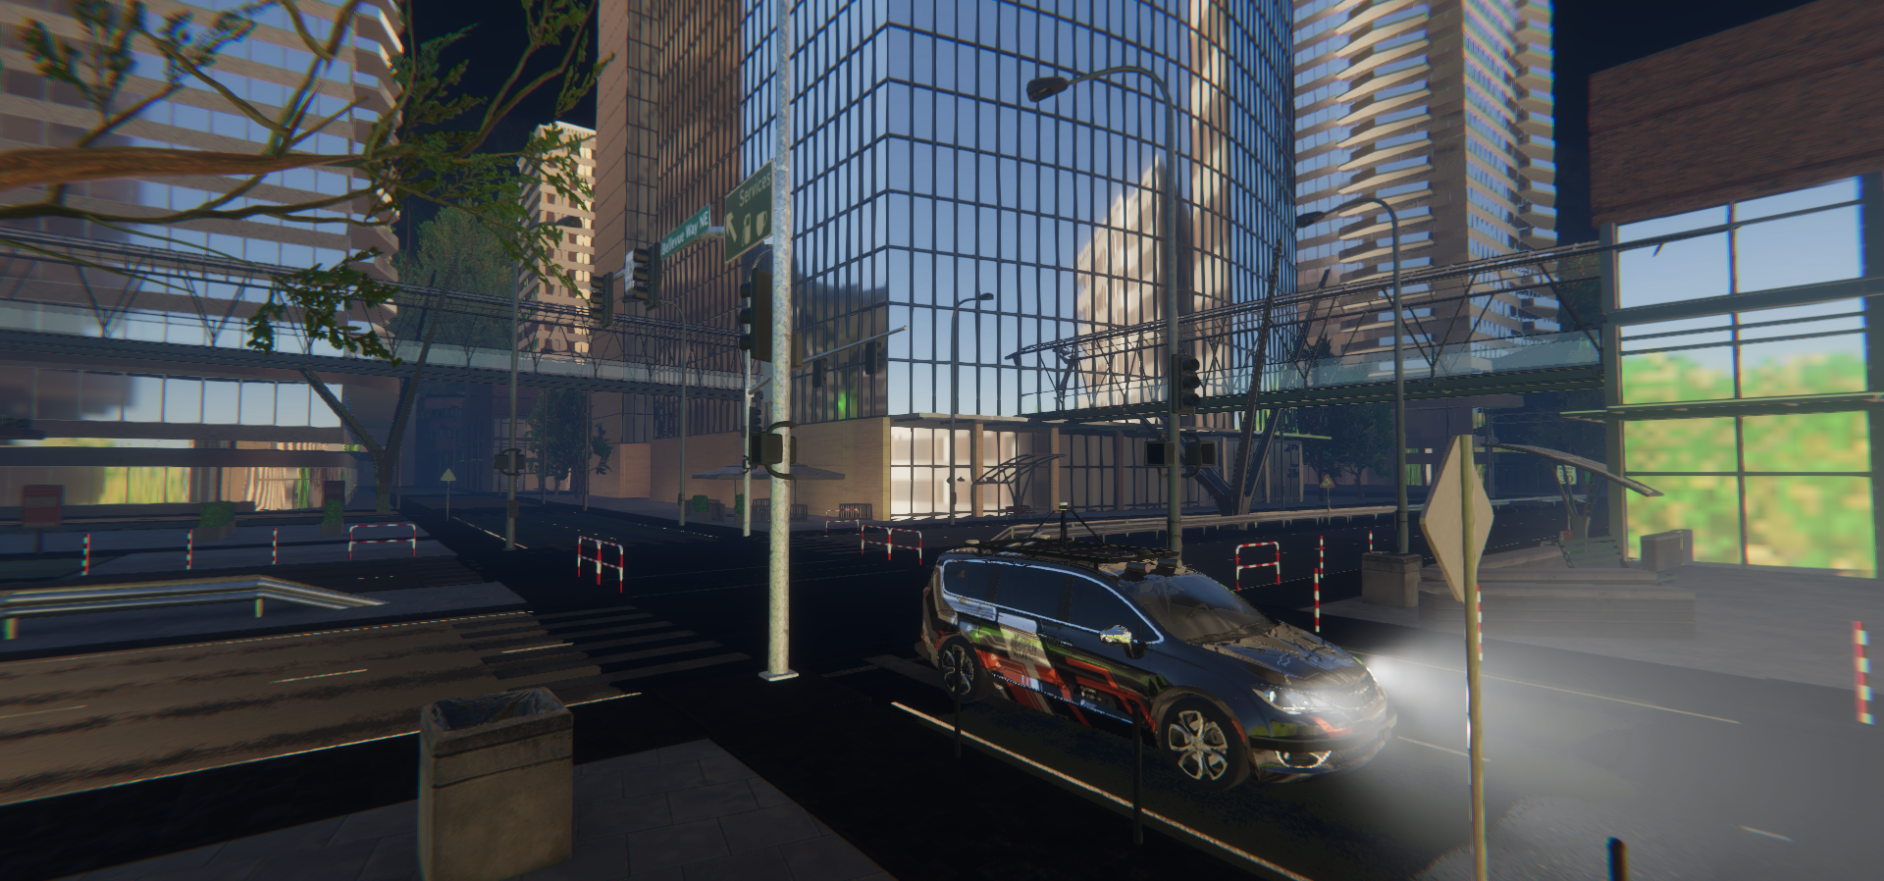
Full-Scale Vehicle Update Summary
OpenCAV
City scenario
RZR
Forest scenario
Dirt Road
Highway
Mountain Pass
Downtown

Slide 10
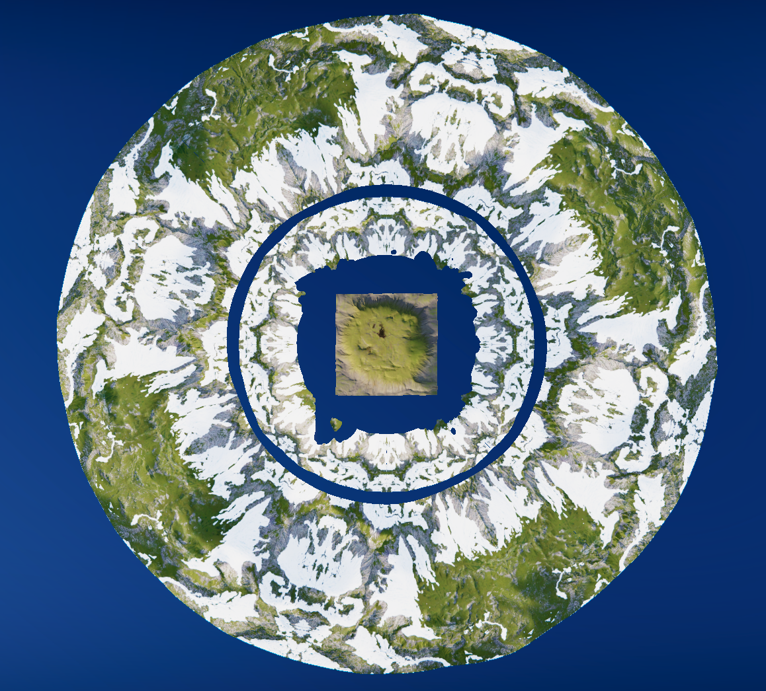
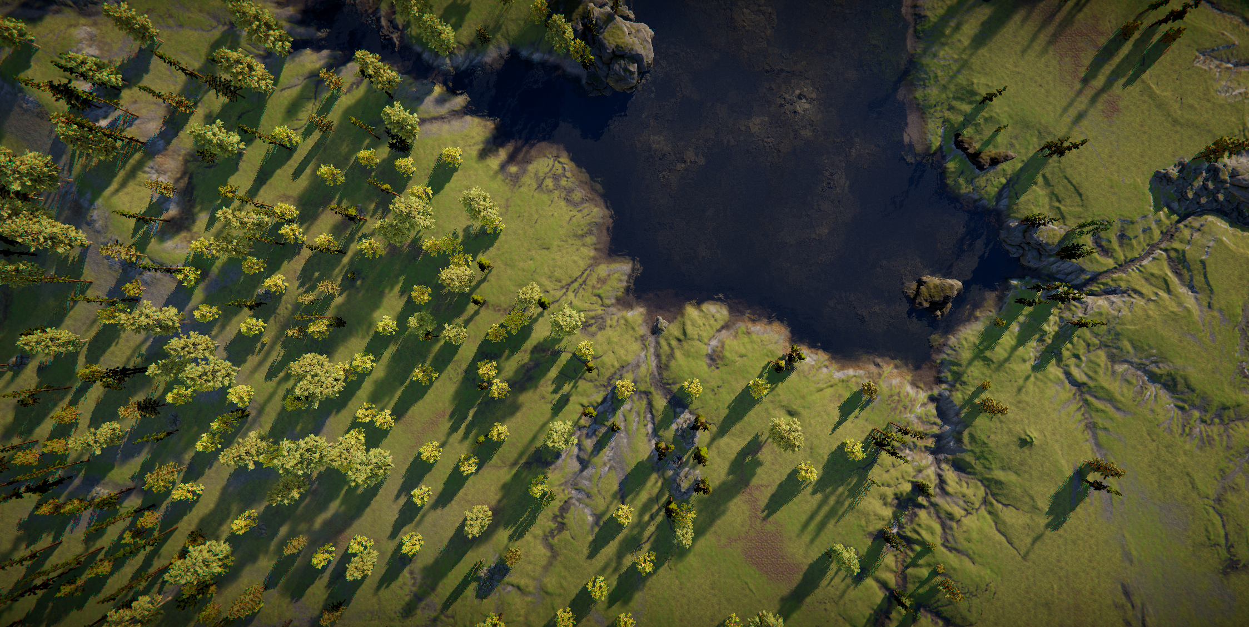
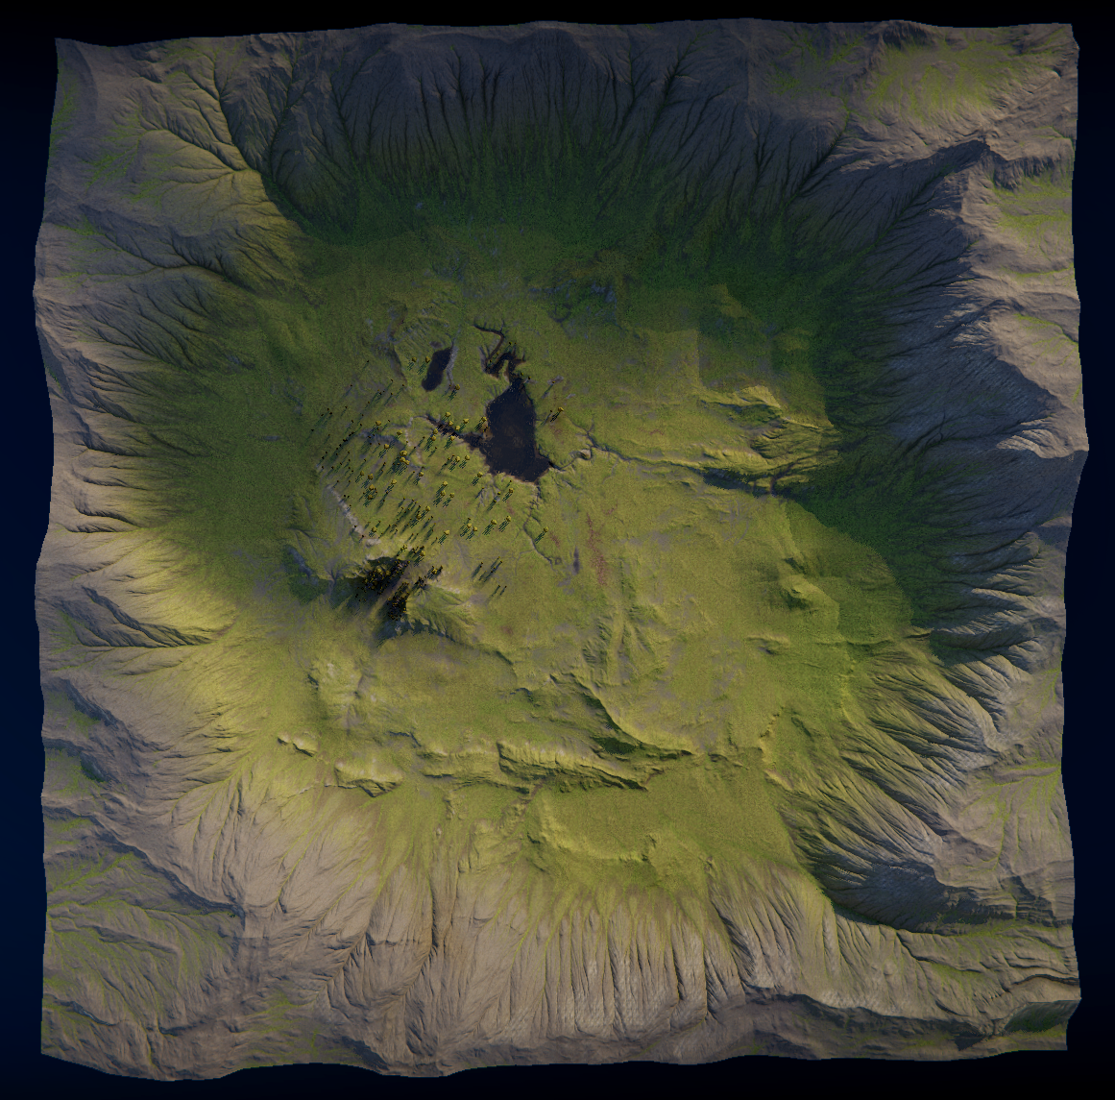
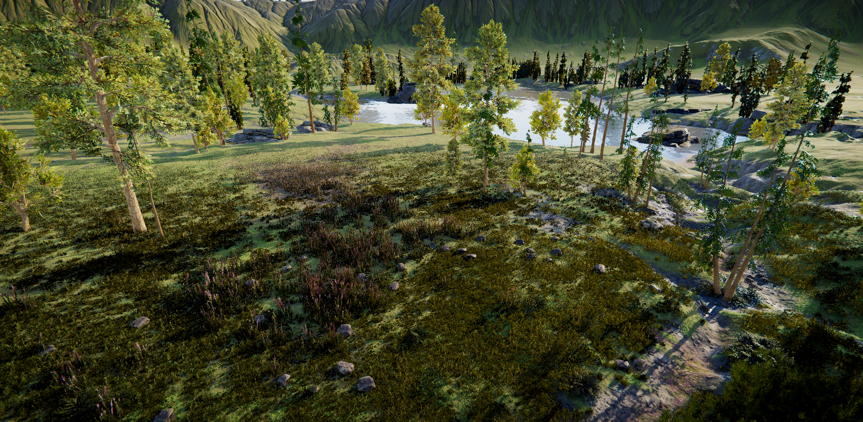
Full-Scale Vehicle Update Summary
OpenCAV
City scenario
RZR
Forest scenario
LEGEND
Uneven terrain
Rough terrain heightmap
Textures (visual)
Obstructions
Soft vegetation (e.g. grass, shrubs)
Hard vegetation (e.g. trees)
Rocks and boulders
Mountains
Mountains at a distance
Smaller hillocks throughout
Water body
Lake at the center of the scene

Slide 11
References
T. Samak, C. Samak, S. Kandhasamy, V. Krovi, and M. Xie, “AutoDRIVE: A Comprehensive, Flexible and Integrated Digital Twin Ecosystem for Autonomous Driving Research & Education,” Robotics, vol. 12, no. 3, p. 77, May 2023, doi: 10.3390/robotics12030077
W. Ding, C. Xu, M. Arief, H. Lin, B. Li and D. Zhao, “A Survey on Safety-Critical Driving Scenario Generation—A Methodological Perspective,” in IEEE Transactions on Intelligent Transportation Systems, vol. 24, no. 7, pp. 6971-6988, July 2023, doi: 10.1109/TITS.2023.3259322
M. Quigley, K. Conley, B. Gerkey, J. Faust, T. Foote, J. Leibs, R. Wheeler, and A. Ng, “ROS: an open-source Robot Operating System,” in ICRA 2009 Workshop on Open Source Software, vol. 3, Jan 2009. [Online]. Available: http://robotics.stanford.edu/~ang/papers/icraoss09-ROS.pdf
S. Macenski, T. Foote, B. Gerkey, C. Lalancette, and W. Woodall, “Robot operating system 2: Design, architecture, and uses in the wild,” Science Robotics, vol. 7, no. 66, p. eabm6074, 2022. [Online]. Available: https://www.science.org/doi/abs/10.1126/scirobotics.abm6074
Autoware Foundation, “Autoware Project: The world’s leading open-source software project for autonomous driving.” [Online]. Available: https://autoware.org

